Slide 1

“Civics 101”
Class #3
Cycle 52
Tom Tresser
March 8, 2023
Notes:
Music = “Power” by Little Mix, featuring Stormzy, suggested by Teanna - https://www.youtube.com/watch?v=Dw8B1q1tKgs

Slide 2
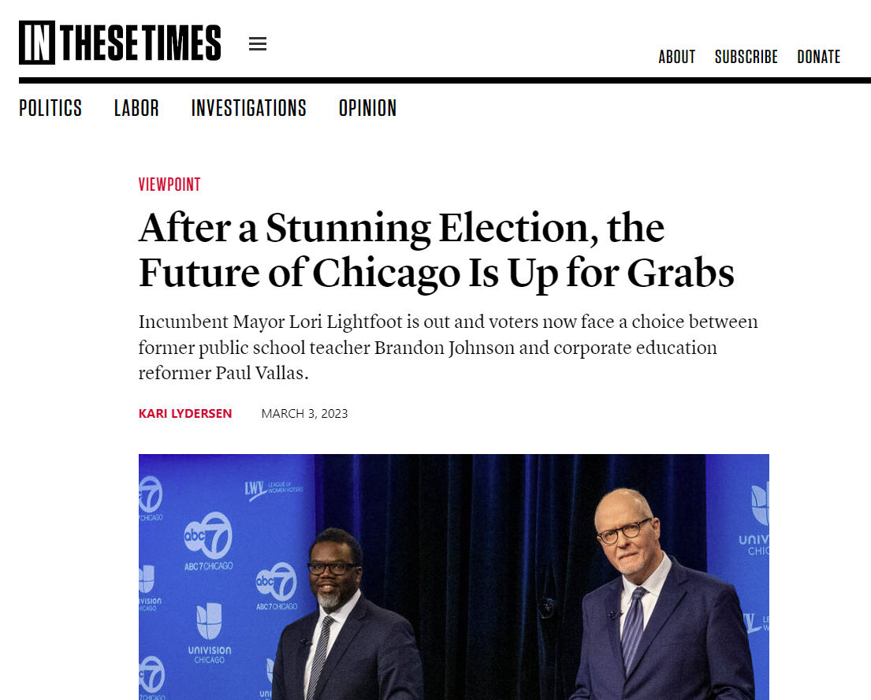
Notes:
https://inthesetimes.com/article/chicago-mayor-election-brandon-johnson-paul-vallas-lori-lightfoot

Slide 3
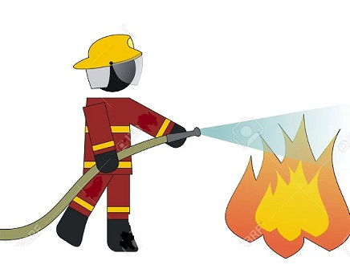
“Putting Out The Fire” Assignment – Due 4th Class – March 15th
http://www.tinyurl.com/Zoom-w-Tom
Notes:
Instructions for your final project “Putting Out the Fire – Addressing my Burning Issue” -> https://tinyurl.com/C51-Assignment
Time for check-ins – anyone need any brainstorming help? Remember, can book 30 min via Zoom by going to http://www.tinyurl.com/Zoom-w-Tom

Slide 4

https://www.yesmagazine.org/issues/a-new-social-justice
Notes:
https://www.yesmagazine.org/issues/a-new-social-justice

Slide 5



What is civic engagement?
Domain 1 – Civic Heart – What is your disposition?
Domain 2 – Civic Brain - What stuff should you know?
Domain 3 – Civic Muscle - What should you be able to do?
Notes:
Repeat the 3 domains.

Slide 6
Domain 1 – Civic Heart
Number One?
Empathy - Love
Notes:
What is Number One? There was a consensus that Empathy and Love was the most important part of the Civic Heart – the foundation, we might say, for all other aspects of civic work.

Slide 7
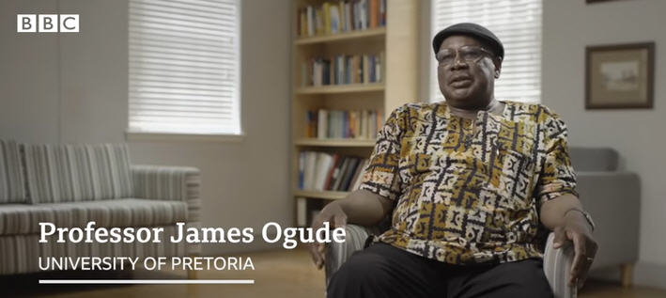
Domain 1 – Civic Heart
Notes:
Introduce the concept of Ubuntu – “I am because you are” – watch BBC video of Prof. James Ogude, University of Pretoria -> https://www.youtube.com/watch?v=7UojwMiRpNM (9 min)

Slide 8
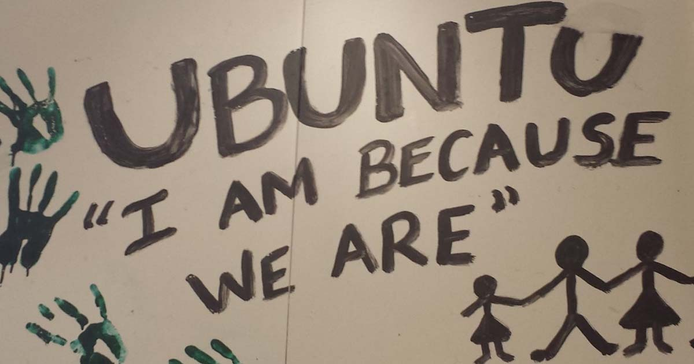
Domain 1 – Civic Heart
Notes:
Discuss how we can build this muscle – become more adept and practice Civic Ubuntu?

Slide 9
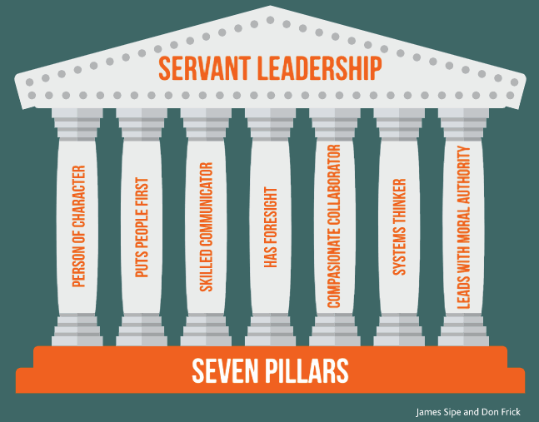
What is Leadership?
Notes:
https://www.greenleaf.org - Get book at https://www.greenleaf.org/products-page/seven-pillars-of-servant-leadership
https://youtu.be/IrCeVwwu0Xc - https://www.slideshare.net/sevenpillarsofservantleadership/seven-pillars-of-servant-leadership-leaderserve-model
- Click to outline “Person of Character” & “Puts People First” as directly connected to our discussions on Empathy/Civic Heart

Slide 10

5 minutes
Notes:
5 minutes

Slide 11
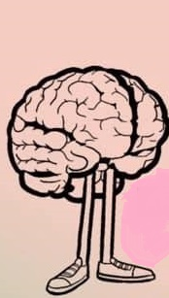

What should be IN our Civic Brain?
Notes:
What should be THE most important things to know in our Civic Brains? Let’s get into four small groups now and take six minutes to review the items you discussed and lift up the MOST important things one should have in one’s Civic Brain.

Slide 12
What should be IN our Civic Brain?
Report Back
Notes:
2 minutes per group

Slide 13
What is civic engagement?
Domain 1 – Civic Heart
Domain 2 – Civic Brain
Domain 3 – Civic Muscle
Notes:
Repeat the 3 domains. Now ready to tackle Domain #3 – Civic Muscle.

Slide 14


Use JamBoard for your group
Please post first names of your group
on your JamBoard
www.tinyurl.com/C101-Civic-Muscle
What should build your Civic Muscle?
Looking for responses around:
Activities you have done
Accomplishments/Experiences
Things you have built/run
Notes:
Use the JamBoard – each group has its own. Go to www.tinyurl.com/C101-Civic-Muscle - 4 groups - Use the JamBoard for your Group #. Please put names of your group into a Sticky.
We will take 10 minutes for this.

Slide 15
Report Back
Domain 3 – Civic Muscle
Notes:
2 minutes per group

Slide 16

And the survey said…

Slide 17
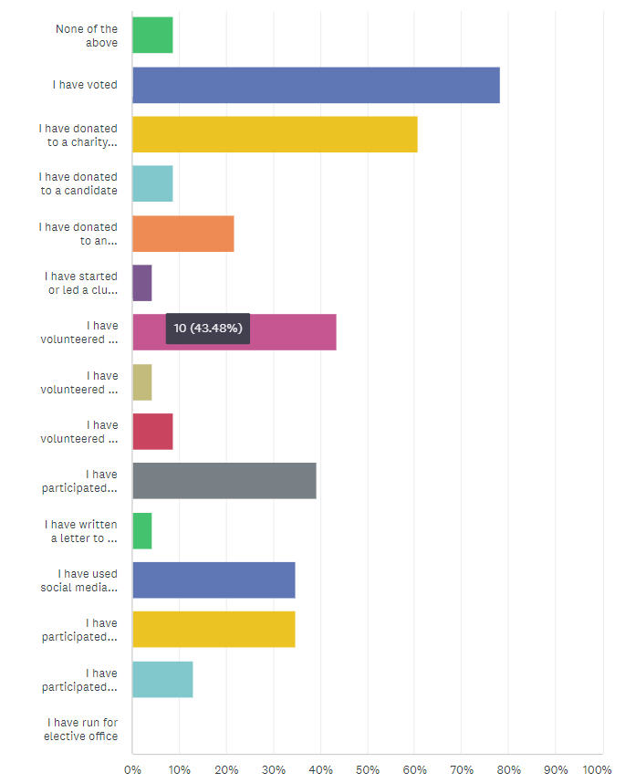
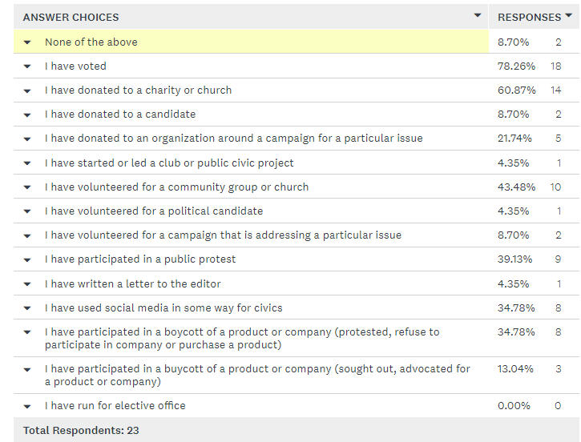
And the survey said…
Notes:
Pass out doc with results.

Slide 18
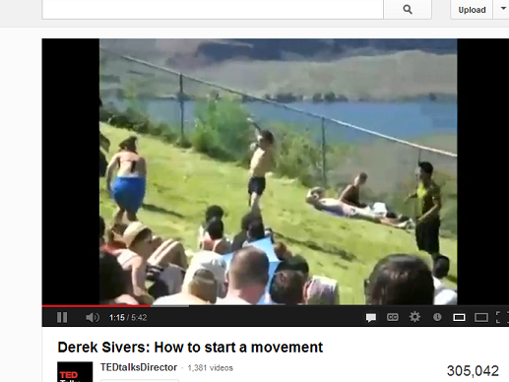
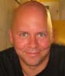
What about the Followers?
https://sive.rs
Notes:
Here is one of the most engaging and informative YouTube videos I’ve seen on the subject of Leadership – only it looks at the aspect of the Follower. (5:41) http://www.youtube.com/watch?v=V74AxCqOTvg (5:42)
- How does this fit into our list of Civic Attributes/Abilities?

Slide 19
Next Class
Notes:
Next class, last session - Interns give their presentations!

