Slide 1
“Civics 101” Class #2
Cycle 52
Tom Tresser March 2, 2023
Notes:
Music: “Peace Train” by Cat Stevens/Yusuf Islam, suggested by Lynetta Currie - https://www.youtube.com/watch?v=Sdq4T3iRV80

Slide 2
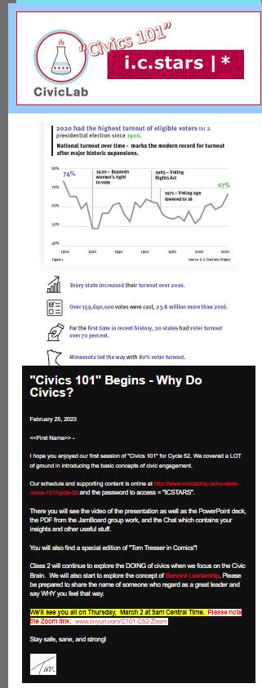
Check your spam…
Notes:
http://mailchi.mp/civiclab/c51-class-6033633

Slide 3
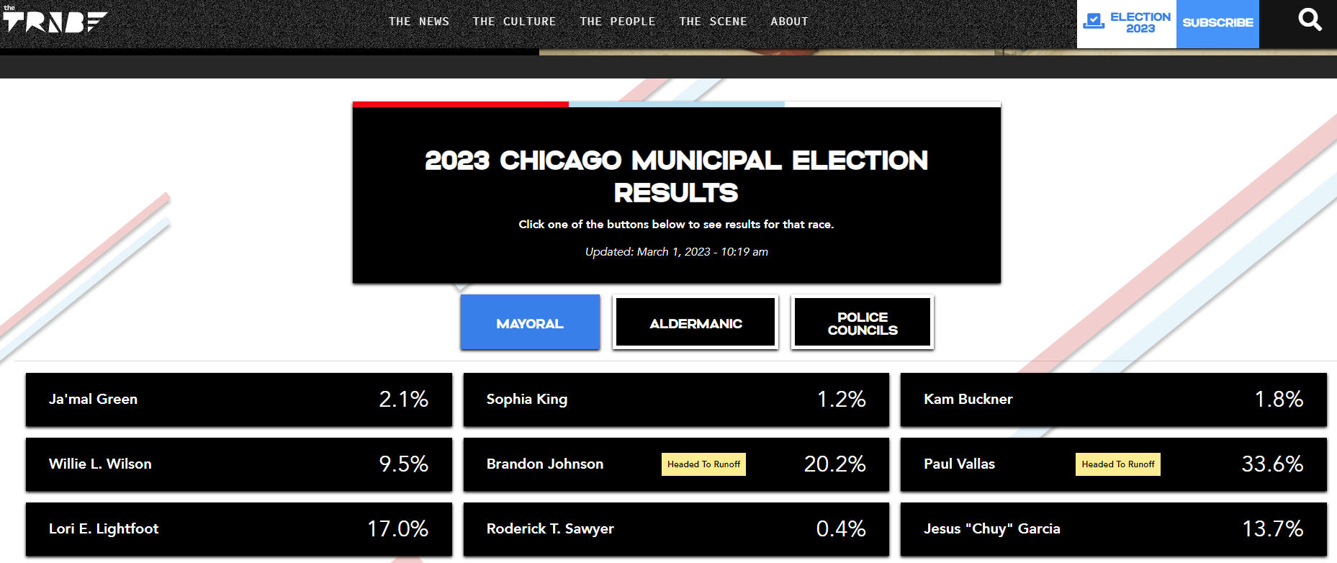
https://thetriibe.com/chicago-elections-2023/#more-reading
Notes:
https://thetriibe.com/chicago-elections-2023/#more-reading – The Triibe is a great local news outfit!
Vallas = 173,630 Johnson = 104,306
https://chicagoelections.gov/en/election-results.asp?election=241
April 4 is run-off
https://app.chicagoelections.com/Documents/general/2023%20Election%20Calendar.pdf

Slide 4
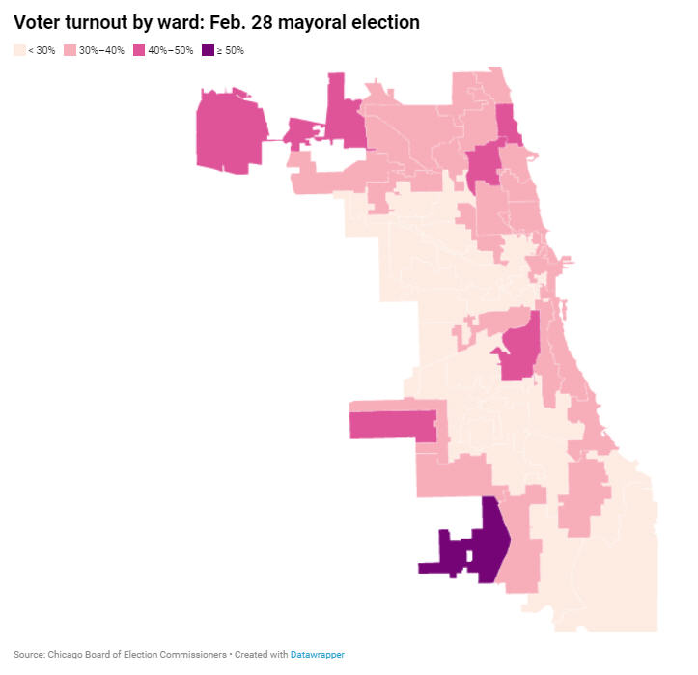
Notes:
https://www.chicagotribune.com/politics/elections/ct-chicago-municipal-election-2023-candidate-votes-by-ward-precinct-20230301-kofelvx67feytcy3wcrc67dkqe-story.html - overall 32% turnout – WHY SO LOW?

Slide 5
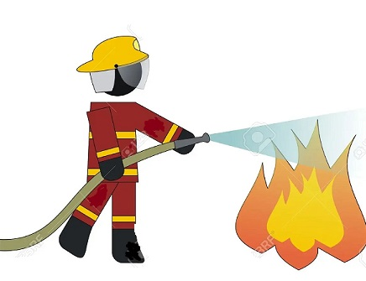
Cycle 52
Notes:
http://www.tinyurl.com/C52-Assignment

Slide 6
Interested in chatting about civics?
http://www.tinyurl.com/Zoom-w-Tom
Notes:
http://www.tinyurl.com/Zoom-w-Tom

Slide 7
Notes:
Cueing up a discussion of PUBLIC. Ask people to put into chat what they think of when they hear the word “public.”

Slide 8
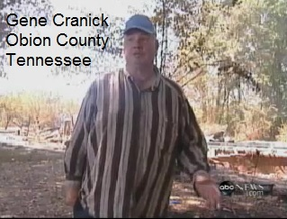
“Pay To Spray”
Homeowner moves to part of county NOT covered by fire protection service and chooses NOT to pay annual fee. His house catches fire. Fire fighters are on scene for another homeowner, who HAS paid. Should they ALSO put out HIS fire?
Notes:
https://www.youtube.com/watch?v=_majRyEUXSc (4 min)

Slide 9
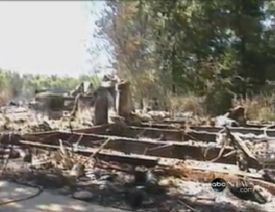
“Pay To Spray” Small Groups
Groups 1 & 3 – Arguments why fire SHOULD HAVE been put out
Groups 2 & 4 – Arguments why fire SHOULD NOT have been put out.
www.tinyurl.com/C101-Pay-Spray-JB
Notes:
Use JamBoards at https://tinyurl.com/C101-Pay-Spray-JB - 10 minutes. Then each group will share their insights.

Slide 10
“Pay To Spray” Small Groups
Groups 1 & 3 – Arguments why fire SHOULD HAVE been put out
Groups 2 & 4 – Arguments why fire SHOULD NOT have been put out.
Report Back
www.tinyurl.com/C101-Pay-Spray-JB

Slide 11
What is civic engagement?
Domain 1 – Civic Heart – What is your disposition?
Domain 2 – Civic Brain - What stuff should you know?
Domain 3 – Civic Muscle - What should you be able to do?
Notes:
Repeat the 3 domains.

Slide 12
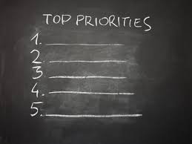
Domain 1 – Civic Heart
Notes:
Let’s go into small groups to review the items you all suggested as needed for the Civic Heart and lift up the Number One trait or characteristic you feel is needed in order for someone to be a powerful, effective, and long-lived civic actor. We’ll have ten minutes for this work.

Slide 13
Domain 1 – Civic Heart
Report Back
Notes:
Report back – 2 min per group.

Slide 14
Domain 1 – Civic Heart
Number One?
Notes:
What is Number One?

Slide 15
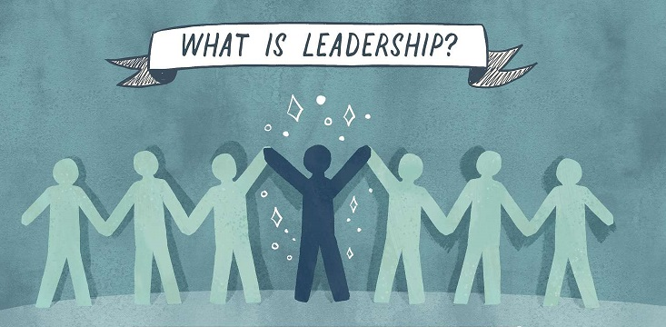
Notes:
Please put into Chat name of person you consider to be a great and effective leader and a few reasons why.

Slide 16
What is Leadership?
Notes:
https://www.greenleaf.org - https://youtu.be/IrCeVwwu0Xc - https://www.slideshare.net/sevenpillarsofservantleadership/seven-pillars-of-servant-leadership-leaderserve-model

Slide 17
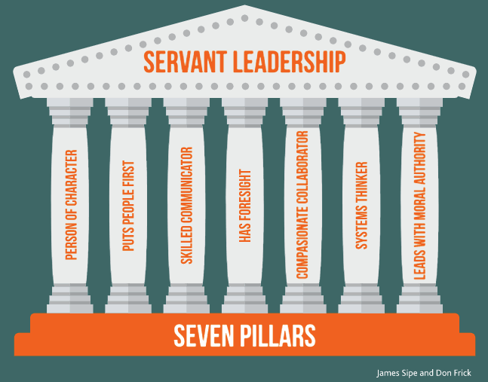
What is Leadership?
Notes:
https://www.greenleaf.org - Get book at https://www.greenleaf.org/products-page/seven-pillars-of-servant-leadership
https://youtu.be/IrCeVwwu0Xc - https://www.slideshare.net/sevenpillarsofservantleadership/seven-pillars-of-servant-leadership-leaderserve-model
- Click to outline “Person of Character” & “Puts People First” & Leads with Moral Authority” as directly connected to our discussions on Civic Heart

Slide 18
What is civic engagement?
Domain 1 – Civic Heart
Domain 2 – Civic Brain
Domain 3 – Civic Muscle
Notes:
Repeat the 3 domains.

Slide 19
Use JamBoard for your group
Please post first names of your group
on your JamBoard
What should be in your brain?
Looking for responses around:
Stuff you should know
Skills you should have
Resources you need
www.tinyurl.com/C101-Civic-Brain
Notes:
Use the JamBoard – each group has its own. Go to www.tinyurl.com/C101-Civic-Brain - Use the JamBoard for your Group #.
We will take 10 minutes for this.

Slide 20
Report Back
Domain 2 – Civic Brain
Notes:
2 minutes per group

Slide 21
Next Class
Civic Muscle!
Notes:
We will look at your own reported civic activities and abilities.

