Slide 1
“Civics 101” Class #1
Cycle 52
Tom Tresser February 23, 2023 - Zoom
Notes:
Music = “Glory” by John Legend - https://www.youtube.com/watch?v=HUZOKvYcx_o - Suggested by Demetri.

Slide 2
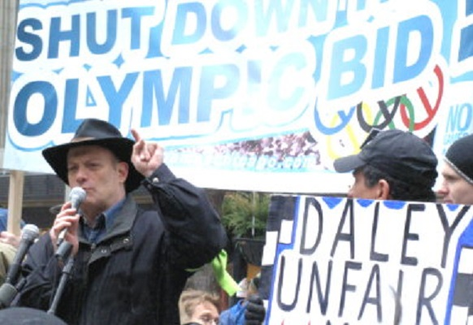
Tom Tresser
www.tresser.com
www.civiclab.us
www.wearenotbroke.org
www.tifreports.com
www.chicagocivics.org
tom@tresser.com
Notes:
Intro survey-> https://www.surveymonkey.com/r/C52-Intro

Slide 3
Why do civics?
www.tinyurl.com/C101-Why-Do-Civics
Notes:
Small groups – 4/5 each – 10 minutes. Please make sure one person keeps notes on Google Doc at www.tinyurl.com/C101-Why-Do-Civics.
One person to report back.

Slide 4
Why do civics?
Report Back
www.tinyurl.com/C101-Why-Do-Civics
Notes:
Report back – 2 minutes per group -> www.tinyurl.com/C101-Why-Do-Civics

Slide 5
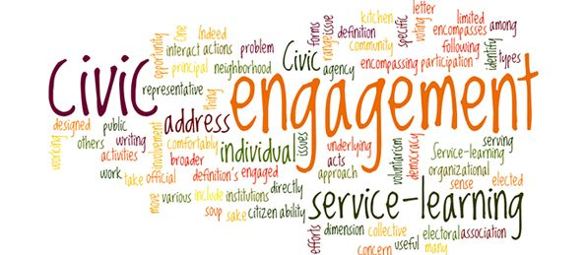
What is civic engagement?

Slide 6
What is civic engagement?
Domain 1 – Civic Heart – What is your disposition?
Domain 2 – Civic Brain - What stuff should you know?
Domain 3 – Civic Muscle - What should be able to do?
Notes:
Now we are ready to talk about how to DO civics.

Slide 7
Notes:
5 minutes

Slide 8
ROLES
Guide – keep on task, mix it up, time
Reporter – key points, insights, questions
What should be your heart or disposition?
Looking for responses around:
Personal traits
States of being/Mindsets
Appetites & Attitudes
Notes:
Use the JamBoard – each group has its own. Go to http://www.tinyurl.com/C101-Civic-Heart - Use the JamBoard for your Group #.
We will take 10 minutes for this. Please make sure each group has a Guide to keep track of time and to make sure everyone has a chance to contribute, and a Recorder to take notes to the JamBoard – although all are welcome to add notes and images as the class progresses.

Slide 9
Report Back
Domain 1 – Civic Heart
Notes:
Report back - 2 minutes per group

Slide 10
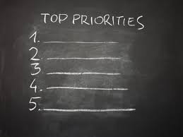
Notes:
Top 3 attributes of the Civic Heart?

Slide 11
Next Class
Civic Brain!

