Slide 1
“Civics 101” Class #2
Tom Tresser September 30, 2022
Notes:
Music: “Heroes” by David Bowie, suggested by Giovanny - https://www.youtube.com/watch?v=lXgkuM2NhYI

Slide 2
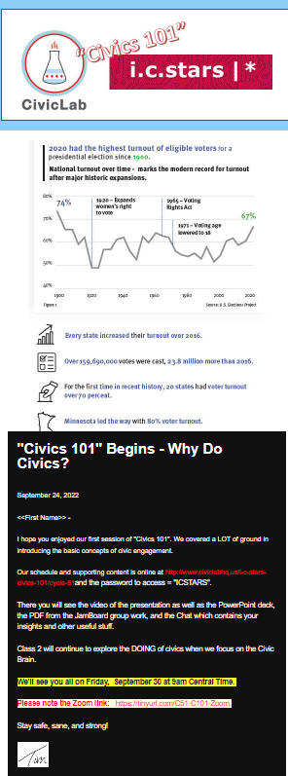
Check your spam…
Notes:
Only 64% open rate…

Slide 3
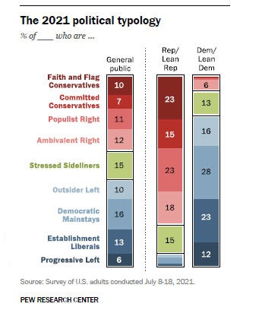
Your Belief System
Notes:
Here’s how we shape up to national results. Were you surprised by the results?

Slide 4
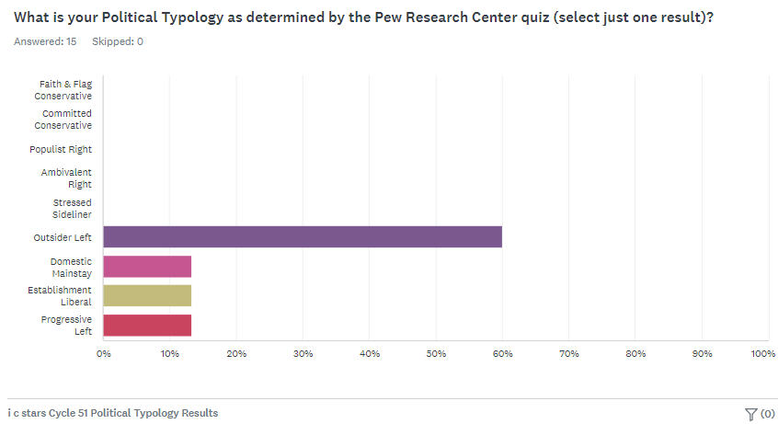
C51 Belief System
Notes:
http://www.pewresearch.org – Let’s take the quiz… www.tinyurl.com/Pew-Political-Type-C51
Place “Pew Political Typology” PDF into Chat. Take quiz, record your Political Typology – Then go to SurveyMonkey to report your type (anonymous)-> = https://www.surveymonkey.com/r/Cycle51
Results = https://tinyurl.com/C51-PT-Results

Slide 5
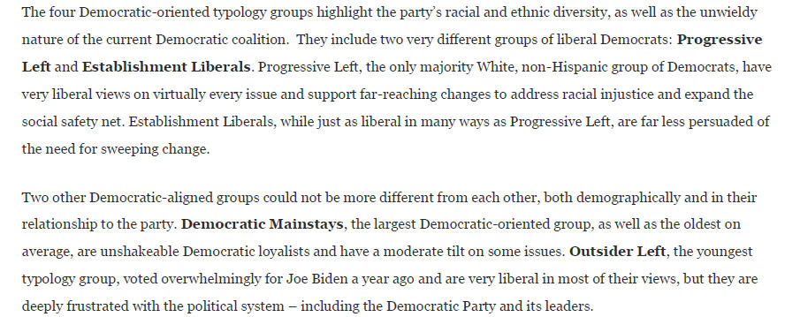
C51 Belief System
Notes:
https://www.pewresearch.org/politics/2021/11/09/beyond-red-vs-blue-the-political-typology-2

Slide 6
What is civic engagement?
Domain 1 – Civic Heart – What is your disposition?
Domain 2 – Civic Brain - What stuff should you know?
Domain 3 – Civic Muscle - What should you be able to do?
Notes:
Repeat the 3 domains.

Slide 7
Importance of Empathy in Civics

Slide 8
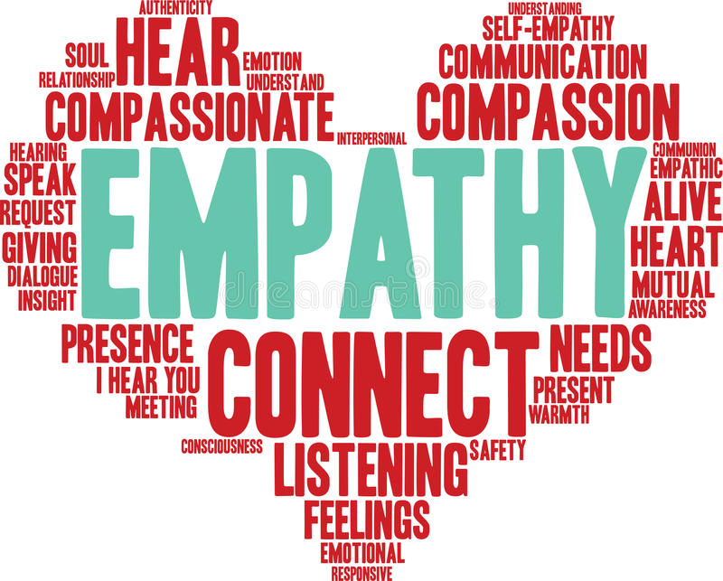
Use JamBoard for your group
Please post first names of your group
on your JamBoard
How can we build/expand our capacity/skill at Empathy?
Notes:
How can we build our Empathy Capacity/Muscle?
Use the JamBoard – each group has its own. Go to https://tinyurl.com/C51-Empathy – Use the JamBoard for your Group #. Put first names on a PostIt note.
We will take 10 minutes for this.

Slide 9
Report Back
Notes:
2 minutes per group

Slide 10
Notes:
5 minutes

Slide 11
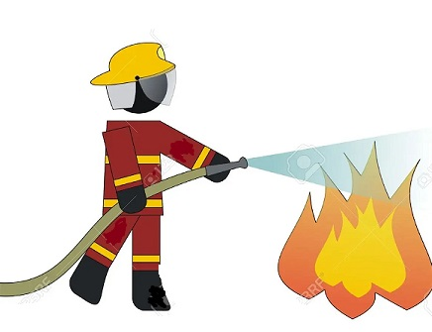
“Putting Out The Fire” Assignment – Due 4th Class – October 12th
Notes:
Instructions for your final project “Putting Out the Fire – Addressing my Burning Issue” -> https://tinyurl.com/C51-Assignment

Slide 12
What is Leadership?
Notes:
https://www.greenleaf.org - https://youtu.be/IrCeVwwu0Xc - https://www.slideshare.net/sevenpillarsofservantleadership/seven-pillars-of-servant-leadership-leaderserve-model

Slide 13
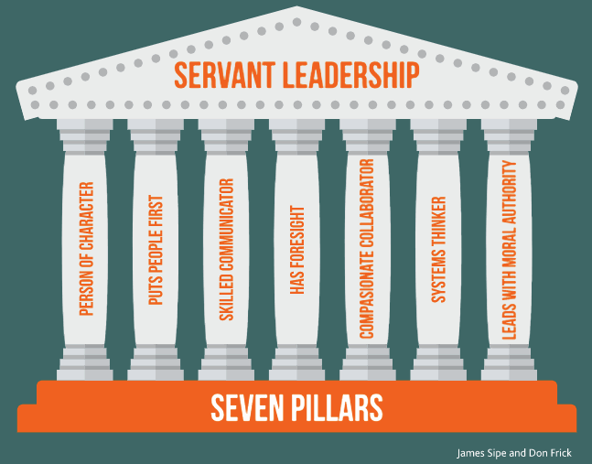
What is Leadership?
Notes:
https://www.greenleaf.org - Get book at https://www.greenleaf.org/products-page/seven-pillars-of-servant-leadership
https://youtu.be/IrCeVwwu0Xc - https://www.slideshare.net/sevenpillarsofservantleadership/seven-pillars-of-servant-leadership-leaderserve-model
- Click to outline “Person of Character” & “Puts People First” as directly connected to our discussions on Empathy/Civic Heart

Slide 14
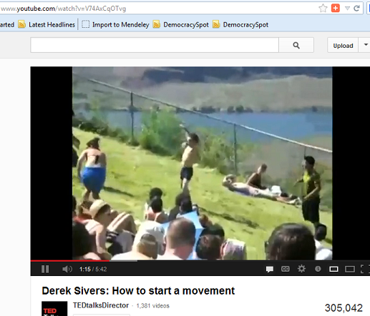
What about the Followers?
Notes:
Here is one of the most engaging and informative YouTube videos I’ve seen on the subject of Leadership – only it looks at the aspect of the Follower. (5:41) http://www.youtube.com/watch?v=V74AxCqOTvg
- How does Empathy show up here?

Slide 15
What is civic engagement?
Domain 1 – Civic Heart
Domain 2 – Civic Brain
Domain 3 – Civic Muscle
Notes:
Repeat the 3 domains.

Slide 16
Use JamBoard for your group
Please post first names of your group
on your JamBoard
What should be in your brain?
Looking for responses around:
Stuff you should know
Skills you should have
Resources you need
Notes:
Use the JamBoard – each group has its own. Go to http://tinyurl.com/C51-CivicBrain-JB – Use the JamBoard for your Group #.
We will take 10 minutes for this. Please make sure each group has a Guide to keep track of time and to make sure everyone has a chance to contribute, and a Recorder to take notes to the JamBoard – although all are welcome to add notes and images as the class progresses.

Slide 17
Report Back
Domain 2 – Civic Brain
Notes:
2 minutes per group

Slide 18
Domain 2 – Civic Brain
Notes:
2 minutes per group

Slide 19
Next Class
Civic Muscle!
Notes:
We will look at your own reported civic activities and abilities.

