Slide 1
“Civics 101” Class #1
Tom Tresser September 23, 2022

Slide 2
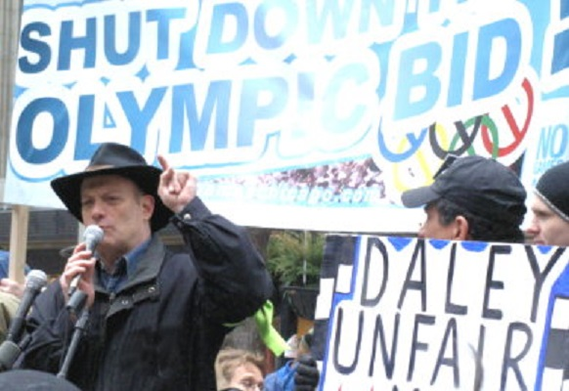
Tom Tresser
www.tresser.com
www.civiclab.us
www.wearenotbroke.org
www.tifreports.com
www.chicagocivics.org
tom@civiclab.us

Slide 3
Why do civics?

Slide 4
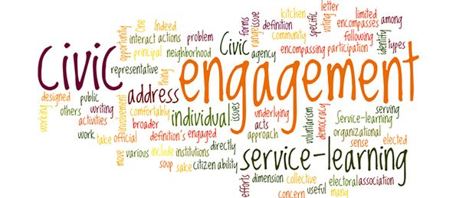
What is civic engagement?

Slide 5
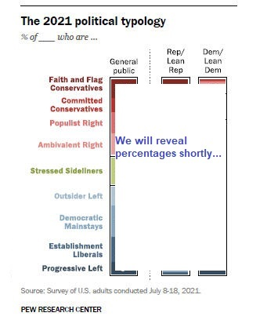
Your Belief System
www.tinyurl.com/Pew-Political-Type-C51
Notes:
http://www.pewresearch.org – Let’s take the quiz… www.tinyurl.com/Pew-Political-Type-C51
Place “Pew Political Typology” PDF into Chat. Take quiz, record your Political Typology – Then go to SurveyMonkey to report your type (anonymous)-> = https://www.surveymonkey.com/r/Cycle51
Results = https://tinyurl.com/C51-PT-Results

Slide 6
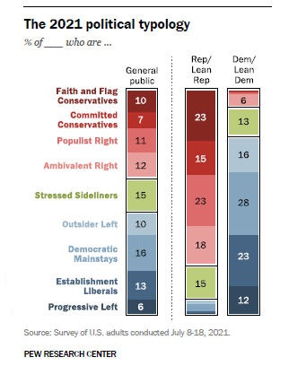
Your Belief System
Notes:
Here’s how we shape up to national results. Were you surprised by the results?

Slide 7
What is civic engagement?
Domain 1 – Civic Heart – What is your disposition?
Domain 2 – Civic Brain - What stuff should you know?
Domain 3 – Civic Muscle - What should be able to do?
Notes:
Now we are ready to talk about how to DO civics.

Slide 8
ROLES
Guide – keep on task, mix it up, time
Reporter – key points, insights, questions
What should be your heart or disposition?
Looking for responses around:
Personal traits
States of being/Mindsets
Appetites & Attitudes
Notes:
Use the JamBoard – each group has its own. Go to https://tinyurl.com/C51-CivicHeart-JB – Use the JamBoard for your Group #.
We will take 10 minutes for this. Please make sure each group has a Guide to keep track of time and to make sure everyone has a chance to contribute, and a Recorder to take notes to the JamBoard – although all are welcome to add notes and images as the class progresses.

Slide 9
Report Back
Domain 1 – Civic Heart
Notes:
2 minutes per group

Slide 10
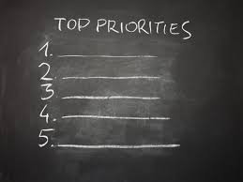

Slide 11
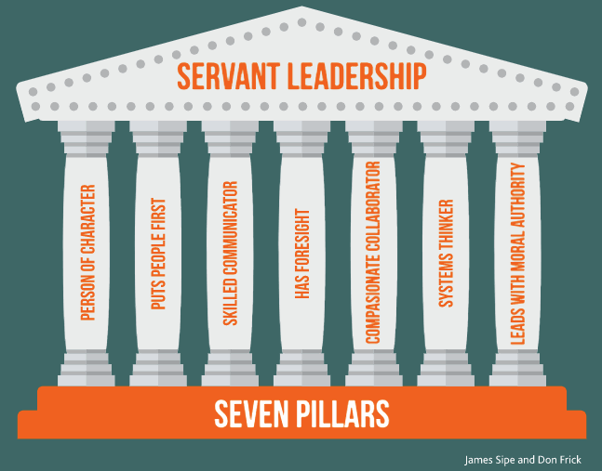
What is Leadership?
Notes:
https://www.greenleaf.org - Get book at https://www.greenleaf.org/products-page/seven-pillars-of-servant-leadership
https://youtu.be/IrCeVwwu0Xc - https://www.slideshare.net/sevenpillarsofservantleadership/seven-pillars-of-servant-leadership-leaderserve-model

Slide 12
What is Leadership?
Notes:
https://www.greenleaf.org - https://youtu.be/IrCeVwwu0Xc - https://www.slideshare.net/sevenpillarsofservantleadership/seven-pillars-of-servant-leadership-leaderserve-model

Slide 13
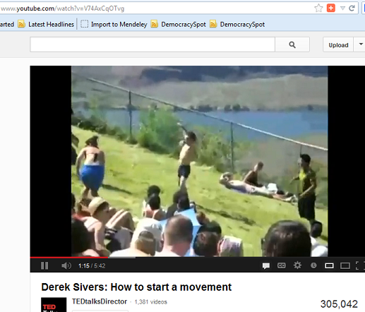
What about the Followers?
Notes:
Here is one of the most engaging and informative YouTube videos I’ve seen on the subject of Leadership – only it looks at the aspect of the Follower. (5:41) http://www.youtube.com/watch?v=V74AxCqOTvg

Slide 14
Next Class
Civic Brain!

