Slide 1



Nonprofit Mission
& Leadership
Tom Tresser – May 2022

Slide 2

Comments/reflections
from Class #2…

Slide 3
Mission Driven not Profit Driven
Nonprofits exist to serve a mission, to respond to a situation or opportunity that has not been addressed. They serve constituents left unserved by the government and for-profit sectors.
It is the mission which provides the meaning and direction of an organization, as well as the uniqueness or niche of an organization.
Notes:
3
The one word that defines our sector is this -> MISSION. We are all mission driven. We are all seeking to serve, to educate, to repair, to solve, to teach or to minister. Without a powerful mission, there can be no nonprofit organization. In fact, the term “nonprofit” is somewhat problematic. It’s awkward to describe an entire portion of society in the negative. Other terms you may hear are: The Third Sector, The Independent Sector and The Helping Sector.
What is the mission of i c stars?
We will spend a lot of time on this next session.

Slide 4

Notes:
Examples of for-profit companies Mission Statements

Slide 5
The Reading Holiday Project uses child-centered, culturally responsive, and high-impact strategies to close the reading achievement gap for young black children.
Digital Undivided uses innovation to create system change by catalyzing economic growth for Black and Latinx communities through women entrepreneurs.
Girl Trek’s mission is to pioneer a health movement for African-American women and girls grounded in civil rights history and principles through walking campaigns, community leadership, and health advocacy.
Sister Song’s mission is to build an effective network of individuals and organizations to improve institutional policies and systems that impact the reproductive lives of marginalized communities.
The Ella Baker Center for Human Rights organizes with Black, Brown, and low-income people to shift resources away from prisons and punishment, and towards opportunities that make our communities safe, healthy, and strong.
Notes:
Examples of nonprofit Mission Statements

Slide 6
6. Street Code Academy empowers communities of color with the skills, mindsets, and networks to use tech and innovation to fulfill their full potential.
7. Think of Us is a systems change non-profit that focuses on leveraging technology to upgrade the foster care system and its programs for better life outcomes for its youth.
8. SisterLove Inc. is on a mission to eradicate the adverse impact of HIV/AIDS and other reproductive justice health challenges impacting women and their families through education, prevention, support, and human rights advocacy in the United States and around the world.
9. The Harlem Academy drives equity of opportunity for promising students, guiding them to thrive at the highest academic levels and one day make a mark on the world.
Notes:
Examples of nonprofit Mission Statements

Slide 7

Small Groups
https://tinyurl.com/Mission-Exercise
Notes:
We will break into small groups – 4 per group. In the small group click over to the dedicated JamBoard and use your group # JamBoard to record what is each Intern’s Burning Issue and to sketch or put a few bullet points around SOLUTIONS – that is the start for building your nonprofit program. We will have each group report back – won’t have time to have each person share where they are with their idea – people can always review the JamBoard – rather, share about the PROCESS of thinking and idea formulation from this exercise. There is already posted on the JamBoard an example sticky note. Each Intern should have at least one. Can add more text or even images if you like. 15 minutes
https://tinyurl.com/Mission-Exercise
Put on a sticky note: - Your name – Potential name of np – What is issue/problem being addressed – Few words describing services to be offered – Neighborhood WHERE this will be located – 5 names/titles of potential board members

Slide 8
Small Groups
Report Backs
https://tinyurl.com/Mission-Exercise
Notes:
Report backs – 4 minutes per group

Slide 9

What Does a Great Leader Look Like?

Slide 10
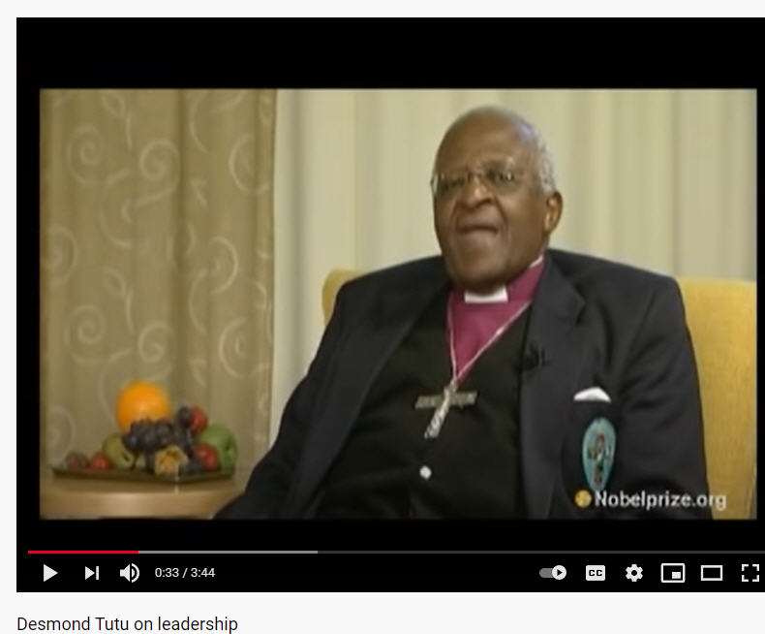
Notes:
https://youtu.be/IrCeVwwu0Xc (3 min, 44 sec)

Slide 11
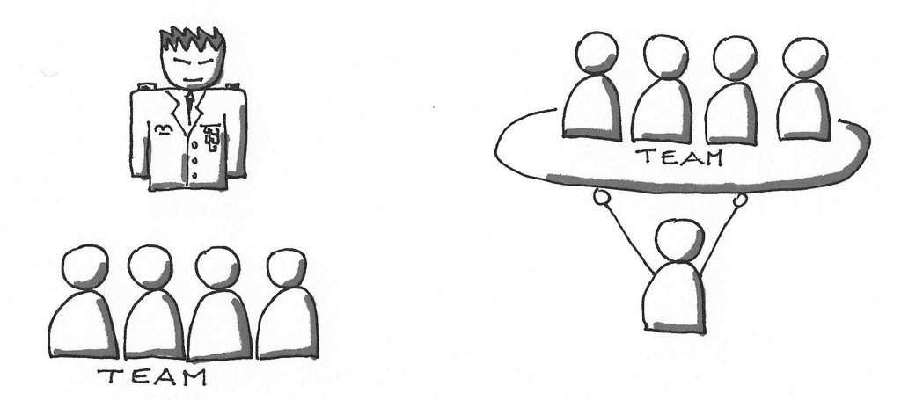
  The Elements of
  Servant Leadership

Slide 12
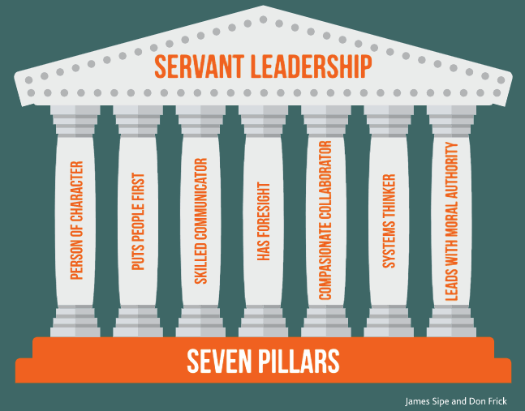
The Elements of
Servant Leadership

Slide 13
Small Groups
Team 1 – Person of character
Team 2 – Skilled communicator
Team 3 – Has Foresight
Team 4 – Leads with moral authority
www.tinyurl.com/C101-JB-C49
Notes:
www.tinyurl.com/C101-JB-C49 - 5 minutes
- Divide interns into 4 teams, each team discuss what behaviors/evidence would demonstrate a trait
- Team 1 – Person of character
- Team 2 – Skilled communicator
- Team 3 – Has Foresight
- Team 4 – Leads with moral authority

Slide 14
Small Groups
Looking for BEHAVIOR that would indicate or give EVIDENCE of the desired leadership trait.
For example: If “Being Well Organized” is a trait of a good leader, then we might assert that such a person would show:
Well prepared for meetings
Has back-up plans when plans go wrong or take unexpected turn
Always does deep homework, well prepared
Can help others get into tasks, assignments
Knows how to run a smooth, productive meeting
www.tinyurl.com/C101-JB-C49
Notes:
www.tinyurl.com/C101-JB-C49 - 5 minutes
- Divide interns into 4 teams, each team discuss what behaviors/evidence would demonstrate a trait
- Team 1 – Person of character
- Team 2 – Skilled communicator
- Team 3 – Has Foresight
- Team 4 – Leads with moral authority

Slide 15
Small Groups
Report Backs
Team 1 – Person of character
Team 2 – Skilled communicator
Team 3 – Has Foresight
Team 4 – Leads with moral authority
http://www.tinyurl.com/CIVICs101-JB-C48
Notes:
http://www.tinyurl.com/CIVICs101-JB-C48 - 2 minutes per team

Slide 16
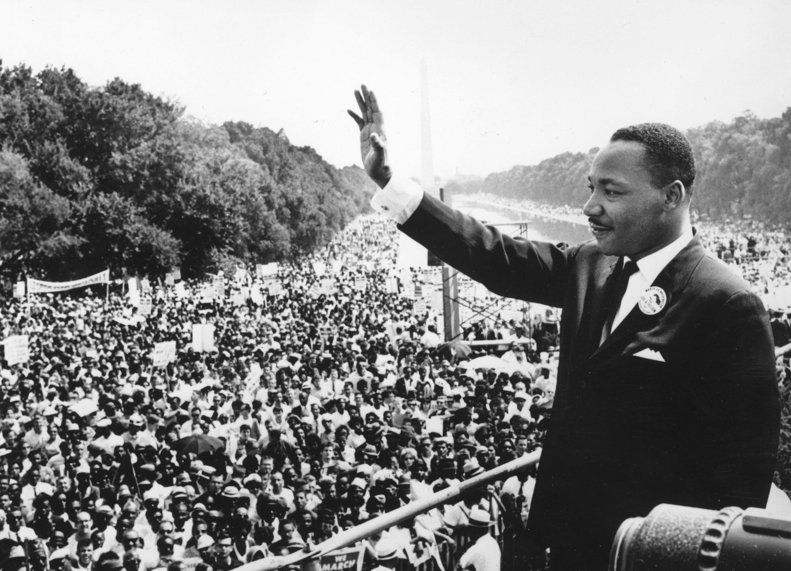
Food for thought…
“Everybody can be great...because anybody can serve. You don't have to have a college degree to serve. You don't have to make your subject and verb agree to serve. You only need a heart full of grace. A soul generated by love.”
Dr. Martin Luthor King, Jr.
Notes:
See you next week!

