Slide 1


Introduction to
the Nonprofit Sector
Tom Tresser – Spring 2022

Slide 2
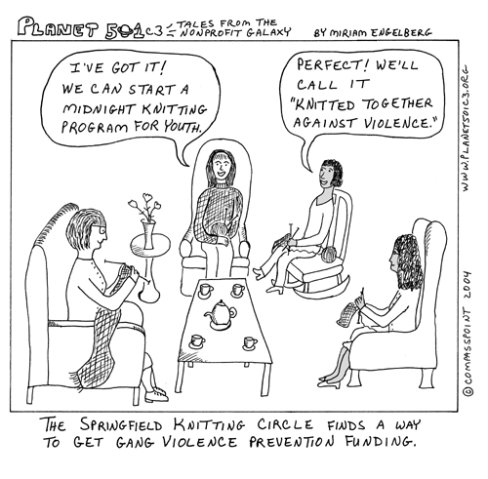
Why Nonprofits?
Notes:
Finally, we want to reflect on WHY nonprofits are such a big deal in America.

Slide 3
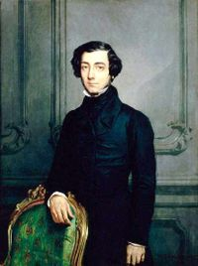
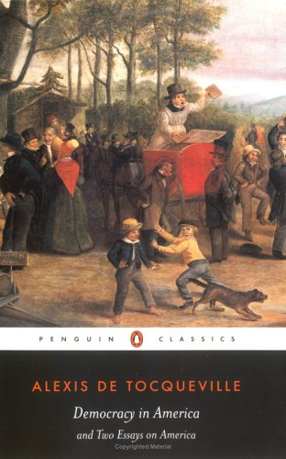
Why Nonprofits?
Alex de Tocqueville (1805 – 1859)
Traveled in America in 1832. Wrote “Democracy in America” 2 volumes published in 1835 and 1840.
Forming associations is part of the American character…
Notes:
A young Frenchman, Alex de Tocqueville, travelled throughout America in 1832. His memoirs of that journey were published as “Democracy in America” and it is still studied for its perceptive take on our country and how we operate.

Slide 4
Why Nonprofits?
“Americans of all ages, all conditions, and all dispositions constantly form associations. They have not only commercial and manufacturing companies, in which all take part, but associations of a thousand other kinds, religious, moral, serious, futile, general or restricted, enormous or diminutive. The Americans make associations to give entertainments, to found seminaries, to build inns, to construct churches, to diffuse books, to send missionaries to the antipodes; in this manner they found hospitals, prisons, and schools. If it is proposed to inculcate some truth or to foster some feeling by the encouragement of a great example, they form a society. Wherever at the head of some new undertaking you see the government in France, or a man of rank in England, in the United States you will be sure to find an association… In democratic countries the science of association is the mother of science; the progress of all the rest depends upon the progress it has made.”
- Democracy in America, Vol. 2
Notes:
Alex was astounded by all the clubs, groups and associations he came upon. His remarks captured an essential truth about Americans DO democracy. We get TOGETHER to collaborate, cooperate, co-create and co-organize.
You’ll note that the contrast between three countries is stark. In France it will be the government that proposes and disposes for problem solving. In England it will be a man of rank (and title). But here, in America, it will be an association of folks who will be driving progress.

Slide 5

Why do you volunteer?
Notes:
Post summary from Introduction Survey

Slide 6



The Three Sectors
Government
For Profit
Nonprofit
Examples
Product
Users
Deliverers
How paid for
How change
www.tinyurl.com/C101-NP-JamBoard
Notes:
We will break up into 3 groups now – each group to focus on one of the three sectors. When you arrive in your groups – pick one person to report back. Use the JamBoards at www.tinyurl.com/C101-NP-JamBoard

Slide 7
The Three Sectors
Report Back
Government
For Profit
Nonprofit
Examples
Product
Users
Deliverers
How paid for
How change
Notes:
Report back – 3 minutes each

Slide 8
Mission Driven not Profit Driven
Nonprofits exist to serve a mission, to respond to a situation or opportunity that has not been addressed. They serve constituents left unserved by the government and for-profit sectors.
It is the mission which provides the meaning and direction of an organization, as well as the uniqueness or niche of an organization.
Notes:
8
The one word that defines our sector is this -> MISSION. We are all mission driven. We are all seeking to serve, to educate, to repair, to solve, to teach or to minister. Without a powerful mission, there can be no nonprofit organization. In fact, the term “nonprofit” is somewhat problematic. It’s awkward to describe an entire portion of society in the negative. Other terms you may hear are: The Third Sector, The Independent Sector and The Helping Sector.
What is the mission of i c stars?

Slide 9
Scope of Nonprofits
The private nonprofit sector comprises
private universities
schools
hospitals & clinics
day-care centers
social service providers
symphonies & museums
arts organizations & theaters
environmental organizations
and many others eligible for tax exemption under
Section 501(c)(3) of the Internal Revenue Code.
Notes:
The nonprofit sector is vast and comprises many different sorts of organizations. Most fit into the category of charitable and educational and are often referred to as “five-oh-one-cee-three” organizations. No, not from “Star Wars” but referencing the section of the Internal Revenue Code that outlines these sorts of organizations for tax exemption. I c stars, for example, is a 501(c)3 entity.

Slide 10
Types of Organizations
Independent Sector, a national coalition of voluntary organizations and foundations, estimates that there are over three million nonprofits, many of which are not registered with the government. These organizations provide
services,
reinforce culture,
advocate, educate,
address faith and spiritual needs,
provide health,
housing,
jobs,
and numerous other objectives.
Notes:
10
Many of these organizations are single issue organizations, especially human and civil rights and environmental organizations, and a number of the organizations have been formed by diverse groups of individuals and communities. Think about your typical week and see if you can count how many nonprofit organizations you interact with.

Slide 11
Key Aspects of Nonprofit Organizations
Social/Operating Distinctions
- Mission driven – created to serve and fulfill “unmet needs”
- Federal np status granted by the IRS – most are classified “501 c 3” (must also file registration paperwork for the state you are in, annual reports to fed, state)
Can earn revenue in excess of operating budget (net surplus, not “profit”)
If organization earns a surplus, that money is plowed back into the organization,
not paid out as dividend or executive bonuses
No one owns the organization
The board of directors serves without pay and represent the community, which
would be viewed as the organization’s true “owners”
- People who use the service of a nonprofit do not pay the full cost of that service
Notes:
The key distinction here is that nonprofits exist to fulfill UNMET NEEDS unsatisfied by Government or the Private Sector (remember the herd of elephants?). The goal is NOT to make money and extract PROFIT but rather to SERVE.
Unlike for-profit companies which are owned by individuals or shareholders – no one really owns a nonprofit. It may be founded by a powerful person who is the CEO or director – but that person does not “own” the organization and can’t sell it. In this sense the nonprofit’s board of directors acts as a steward for the organization, guiding it on behalf of the community and keeping it “honest,” so to speak, and focused on its MISSION. Revenues may be earned, of course – think of the tuition you pay to Adler – and nonprofit executives can be well compensated. But if the nonprofit earns more money than it spends – we don’t call that sum “profit” as it is “revenue in excess of expenses” and that sum is to be put back INTO the organization to further programming. No shareholder dividends are issued as there are no shareholders.
And here is another key distinction that follows from all the others – the users who consume a nonprofit service never pay the full cost of providing that service.

Slide 12
Sources of Revenue for Nonprofits
Donations from individuals (donated $ & services)
Grants from corporations, foundations and government (donated)
Sales of goods and services, including ticket sales (earned)
Government contracts (earned)
Notes:
Now let’s look at where nonprofits get their money. We generally think of two big buckets – “Earned” income is from services and fees and “Unearned” or “Donated” income is from gifts of all sorts. Your tuition to Adler would be an example of “sales of goods and services.”

Slide 13
A KEY DISTINCTION OF ALL NONPROFIT ORGANIZATIONS –
THEY PROVIDE SERVICES TO PEOPLE WHO DO NOT PAY THE FULL COST OF PROVIDING THOSE SERVICES. IN MANY CASES THE USERS PAY NOTHING AT ALL.
Notes:
This is worth repeating. Nonprofits provide services to people who do not pay the FULL cost of providing that service. In many cases the users pay nothing whatsoever. Does this sound odd? Think of any nonprofit you engage with – including Adler University – despite the fact that you pay a fee, if you add up all the users of the service and total up ALL their fees, you will not approach the total COST of operating the organization. More on revenue in a moment…

Slide 14
The Nonprofit Revenue Gap
This is
what the users pay
Notes:
This chart shows the percentage of revenues nonprofits enjoy from different sources. We are most interested in the light blue portion that indicates the percentage that FEES represents for different types of nonprofits. Across the entire sector, the average is 49% for “Fees for services” – what is the major conclusion you draw from this chart?

Slide 15
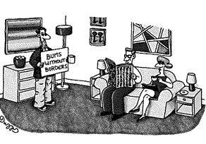
How Big is the Nonprofit Sector?
Notes:
How big is the Nonprofit Sector in America? Big. Very big.

Slide 16
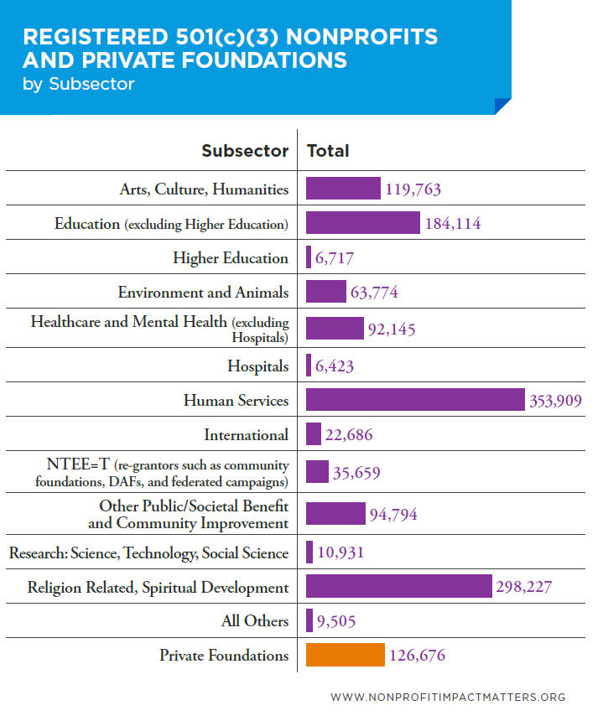
1,425,024
The 501(c)3 organizations are what we typically experience as
“nonprofit” organizations
Notes:
There are almost TWO MILLION nonprofits in America. Of the charity/service/expressive type organizations – the 501 c 3 organizations that we are most familiar with over 1.4 million! I c stars would be seen as an “education” organization
and would be that company. Other examples of nonprofits NOT in this classification – cemeteries, labor unions, trade associations, veterans' groups. Also – houses of worship are NOT required to register with the Internal Revenue Service
so the # of “Religion Related” organizations is much higher than shown here.

Slide 17
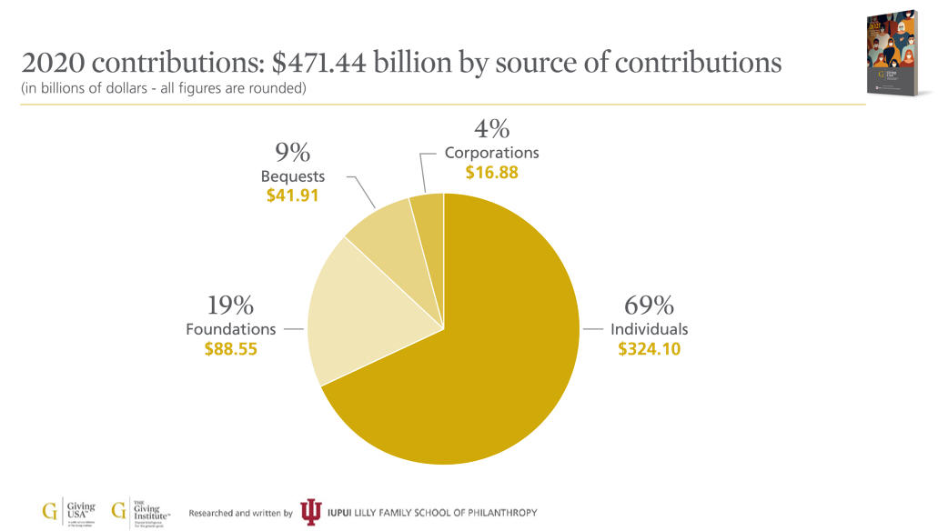
How Big is the Nonprofit Sector?
Who gives?
Notes:
In 2020 over $47` BILLION was contributed to America’s nonprofit organizations! The biggest chunk by far was from individuals. This is always the case. In 2020 people gave $324 BILLION to charitable organizations! Do YOU give to organizations? Think about why or why not. What makes you donate? Put in the chat.

Slide 18
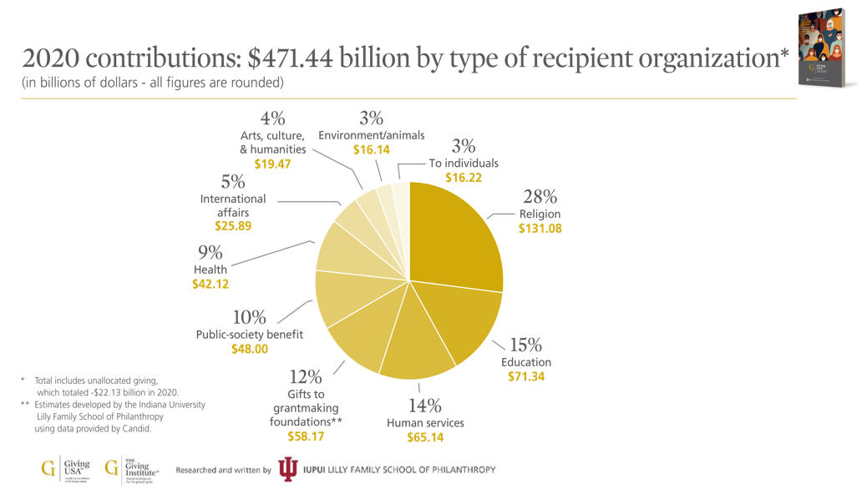
How Big is the Nonprofit Sector?
Who gets?

Slide 19
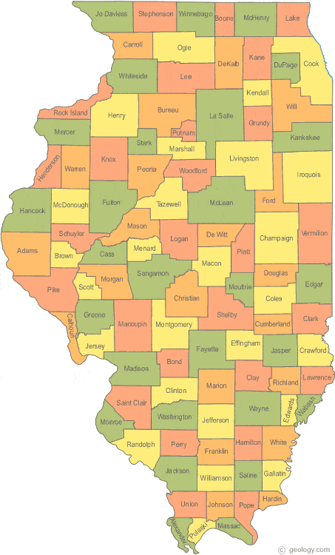
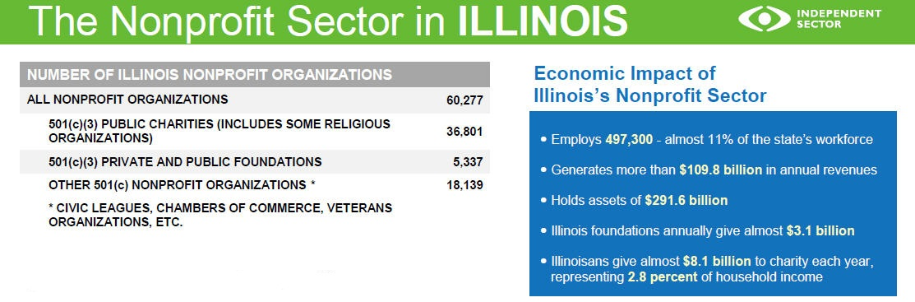
Notes:
There are a LOT of nonprofits in Illinois!

Slide 20
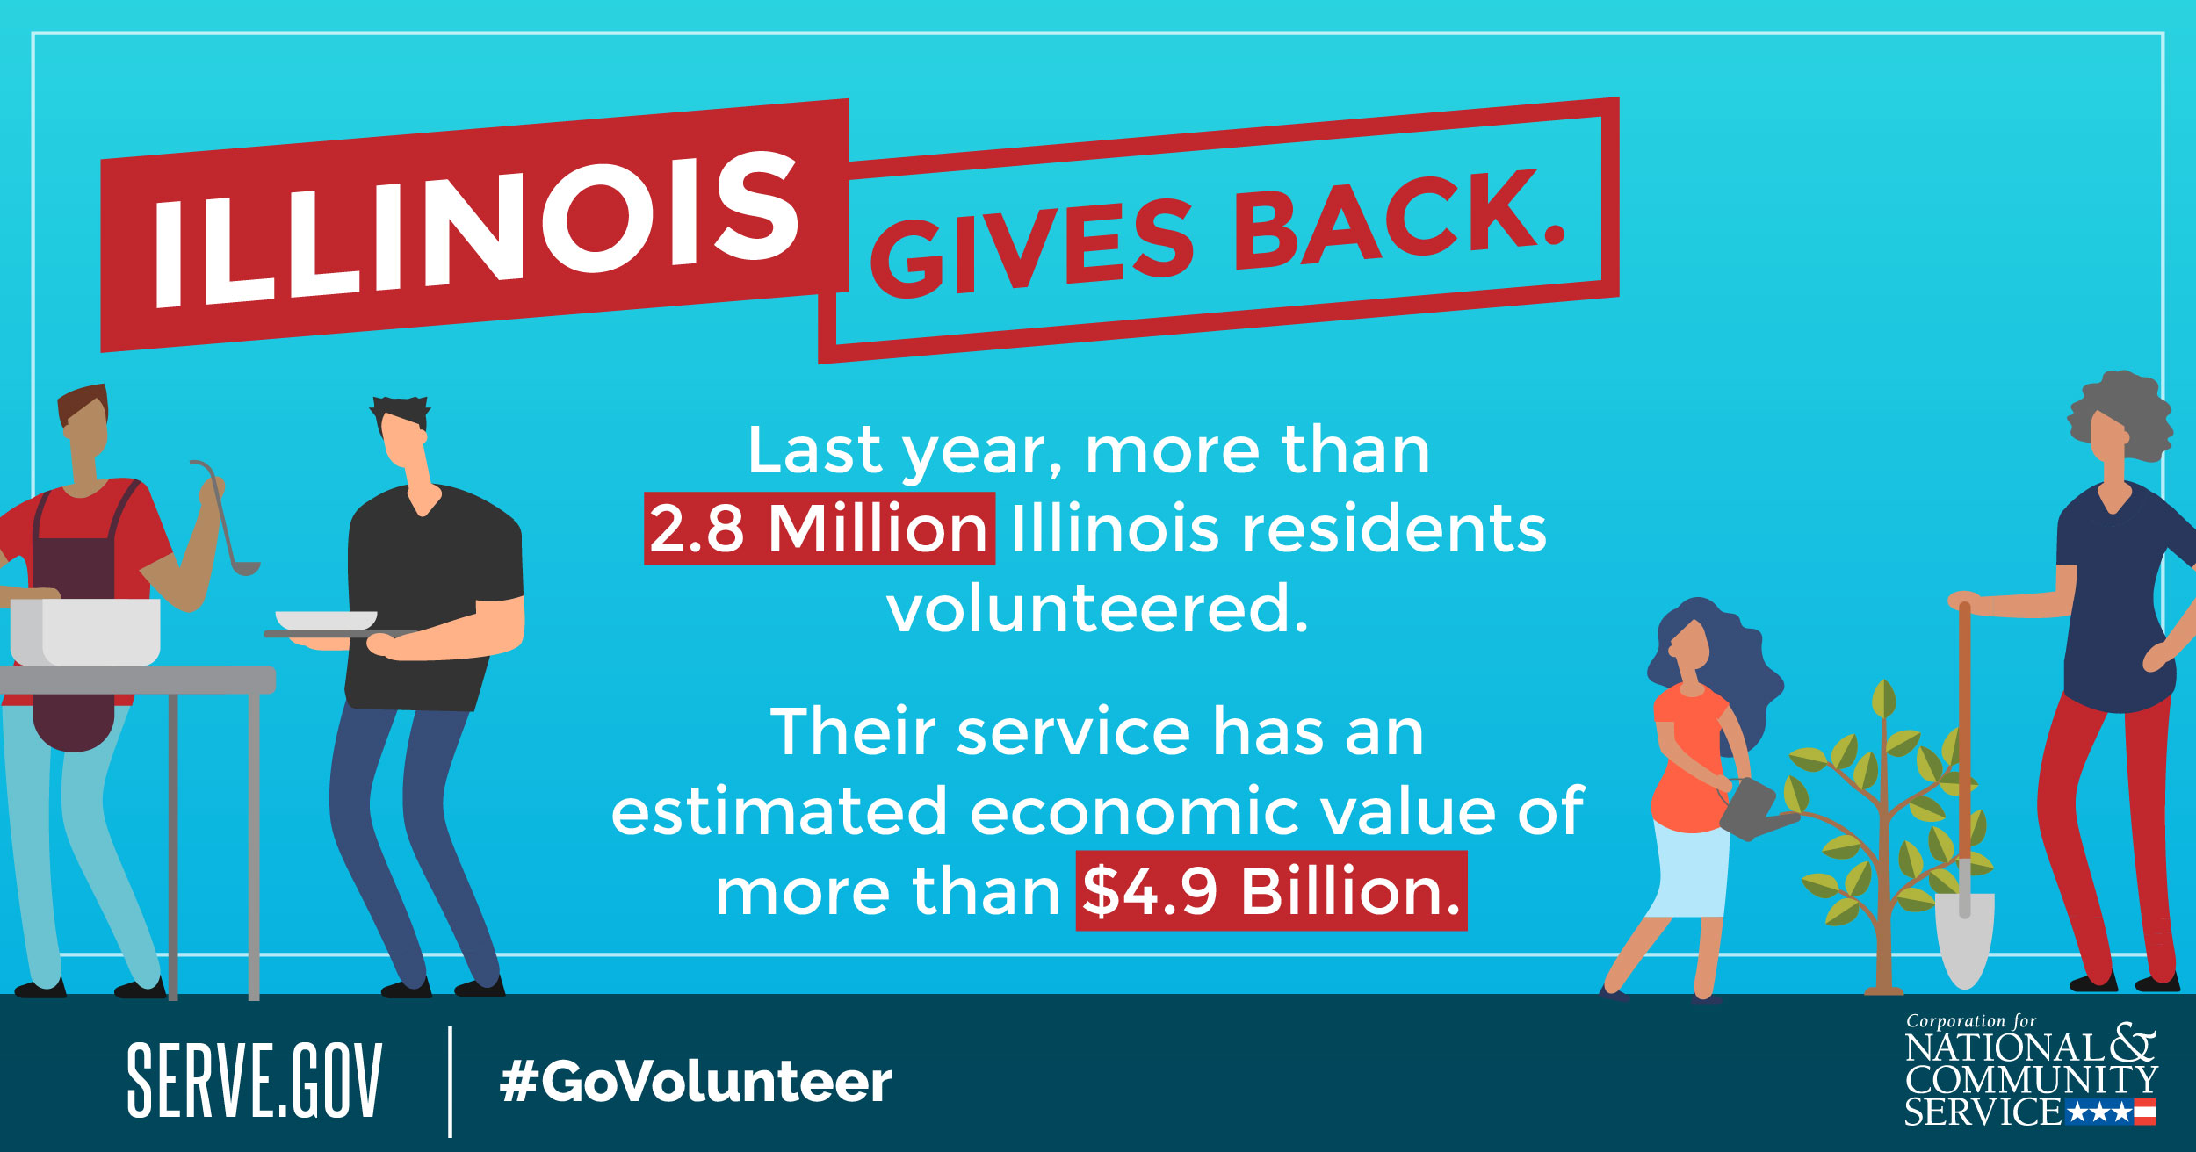
Notes:
America’s nonprofits can do very little without her millions of volunteers. In 2018 77.3 million adults in the USA volunteered an astonishing 6.9 billion worth an estimated $167 billion. Millions more are helping friends and family and doing favors for neighbors – making the real total of “helping labor” off the charts.
Have YOU volunteered for an organization or cause? Why? Why not?

Slide 21
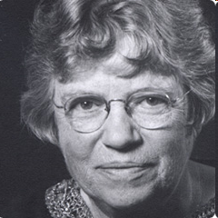
Food for thought…
“Never doubt that a small group of thoughtful committed citizens can change the world. Indeed it’s the only thing that
ever has.”
Margaret Mead, anthropologist
Notes:
At I want to leave you with a quote that is affixed to the wall above my desk at home.

