Slide 1


Nonprofit Sustainability
Tom Tresser – November 2021
Notes:
Music: “The Fire” by the Roots, suggested by Emmanuel - https://www.youtube.com/watch?v=n94URvpQOAc
Music: “To Dream the Impossible Dream” - https://www.youtube.com/watch?v=TZBLAmdULkQ

Slide 2
Comments/reflections
From Class #3…

Slide 3

  What keeps us going?
Notes:
Difference between a for-profit -> revenue from sales, investments / government -> taxes, fees, borrowing

Slide 4
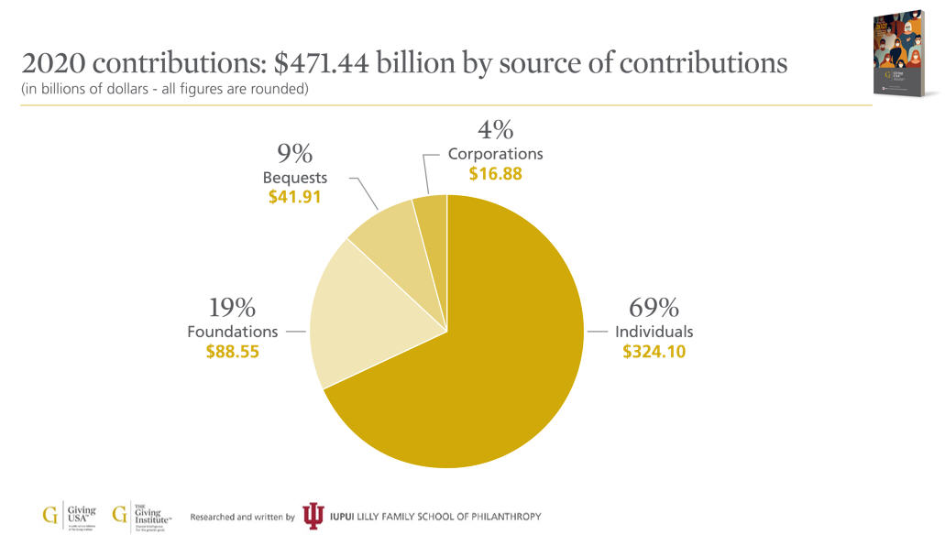
Sources of Revenue for Nonprofits
Who gives?
Notes:
In 2020 over $47` BILLION was contributed to America’s nonprofit organizations! The biggest chunk by far was from individuals. This is always the case. In 2020 people gave $324 BILLION to charitable organizations! Do YOU give to organizations? Think about why or why not. What makes you donate? Put in the chat.

Slide 5

Why?
Notes:
Think about your own charitable behavior. Why do you donate to a cause or organization? Open it up to Intern input.

Slide 6

Nonprofits & Money
Nonprofits pay no state or federal income taxes
Nonprofits may be exempt from paying sales tax
Nonprofits that own property pay no property tax for those properties
Nonprofits DO pay payroll taxes for full-time employees
If you donate to a nonprofit you may be able to DEDUCT some part of that gift from your owed federal income tax
If a nonprofit takes in MORE $ than it spends, those “excess” funds are to be used to improve and shore up the organization

Slide 7
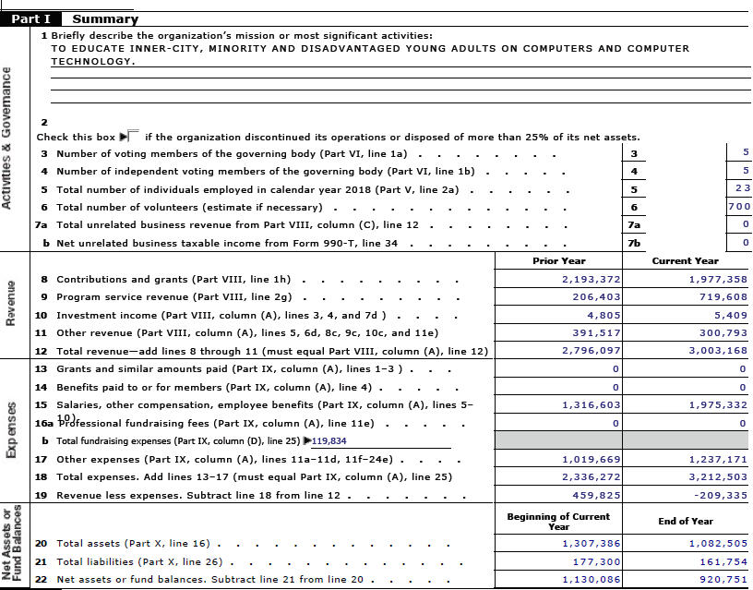

2018 Form 990
Notes:
Let’s see how a mature and successful organization like i c stars brings in revenue. This page is from the organization’s 2018 990 form that is filed with the Internal Revenue Service. Review each line in “Revenue” – what can we learn from this?
GuideStar profile = https://www.guidestar.org/profile/36-4253411

Slide 8
Unearned Income – Donated out of love, support for mission
Earned Income – Paid for services
Unearned Income = grants from any source, donations from any source = $1,977,358 PLUS
Revenue for Gala or special event fundraisers = $300,793
TOTAL Unearned Income = $2,278,151
Earned Income =$719,608 PLUS
Income from investments = $5,409
TOTAL Earned Income = $725,017
TOTAL REVENUES FOR 2018 = $3,003,168
Notes:
Lay out distinctions of unearned versus earned revenues. Walk through the numbers. Nit deficit for 2018.

Slide 9
Why?
Reputation
Excellence of programming = Effectiveness (Evidence)
Consistent/creative communications
Personal connections
Notes:
Part of the ability to sustain your nonprofit depends on ability to document your successes, tell a powerful and compelling story that supporters can relate to – that
will help explain your org to new people and shore up connection with constituents and stake holders.

Slide 10
The Board of Directors
Legal stewards of the nonprofit
Hires/evaluates CEO
Oversees planning, keeps org true to mission
Ensures programs are high quality/effective
Ensures that org has the resources needed
Ensures compliance with rules/regs
Promotes org to larger community/domains

Slide 11

The Board of Directors
Select members for:
Domain expertise/leadership
Wealth/connections
Representing defined constituencies/locations/life experiences

Slide 12
The Board of Directors
Unpaid
Monthly (or quarterly) meetings
Committee work
Bring expertise and experience to the governing of the org
Annual financial commitment
Show up/Help out/Mentor

Slide 13
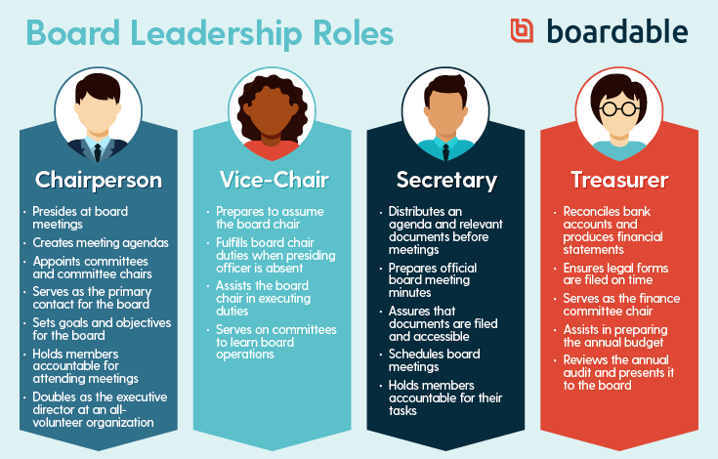
https://boardable.com/blog/board-member-responsibilities
Notes:
Board of Director leadership roles

Slide 14
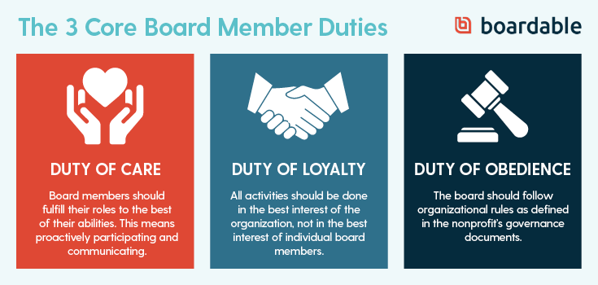

Slide 15
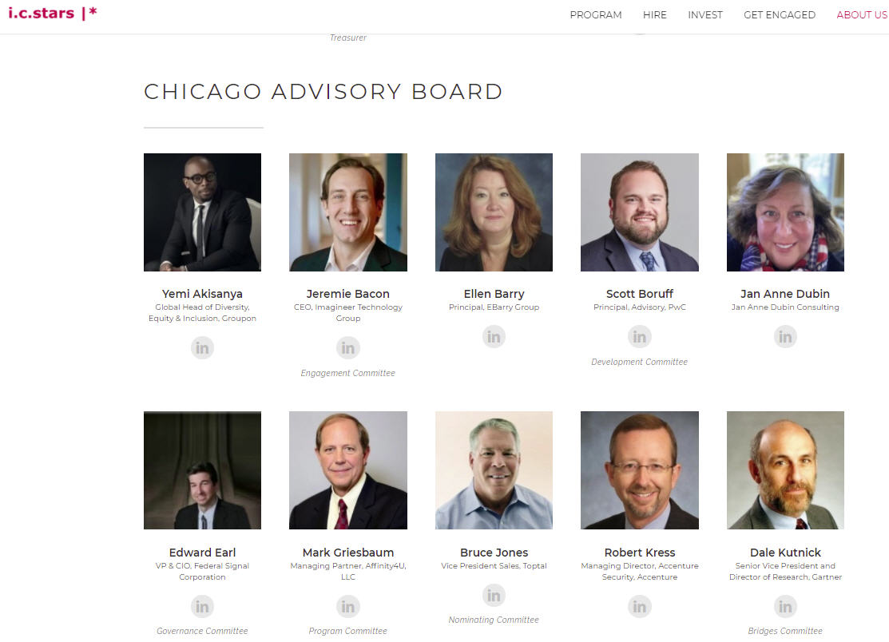
Notes:
This is the Chicago Advisory Board for i c stars. https://www.icstars.org/our-board

Slide 16
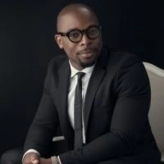
Yemi Akisanya
Global Head of Diversity, Equity and Inclusion, Groupon
Was Head of Diversity & Inclusion, Options Clearing Corporation (Under the SEC)
Yemi held positions at Chicago Mercantile Exchange and JP Morgan Chase as a Lead QA Analyst, where he specialized in large-scale initiatives for the financial services industry
On the Advisory Board of the Nigerian Stock Exchange.
Notes:
Yemi’s LinkedIn profile - https://www.linkedin.com/in/yemiakisanya
Please share your story – the arc that brought to Groupon and your role there.
Comments about the role of “diversity” in business – in civics.
How did he meet Sandee. Why did he decide to help i c stars
What does the Advisory Board do?
Where does he see i c stars in the Chicago/US tech ecosystem
Words of advice for the Interns

Slide 17

Time to discuss…
Notes:
Remaining time open to Interns sharing ideas or hang-ups with the final assignment. Test drive Mission Statement, if helpful.

Slide 18

Last class is November 22…
www.tinyurl.com/icstars-NP-Construction
Notes:
Run through expectations – Post to SlideShare…set privacy settings to allow downloads, please. www.tinyurl.com/icstars-NP-Construction

Slide 19
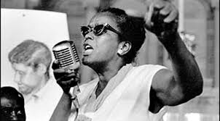
Food for thought…
“You didn't see me on television, you didn't see news stories about me. The kind of role that I tried to play was to pick up pieces or put together pieces out of which I hoped organization might come. My theory is, strong people don't need strong leaders. Give light and people will find the way.”
- Ella Baker
Notes:
See you next week!

