Slide 1
i.c.stars cycle 48 Outline
Introduction
Org name
Mission statement
Location
Urgency of issue
Broad members
Q&A

Slide 2
Introduction TROY GASTON
Cycle 48 ICSTAR intern
Senior at Roosevelt University
McNair scholar
Potential Ph.d candidate
Human rights and community activist
This Photo by Unknown author is licensed under CC BY-NC-ND.
This Photo by Unknown author is licensed under CC BY-NC-ND.
Notes:
Troy Gaston: "Hood" (Help Others Overcome Damage) mission is to connect displaced and dispossessed families in underrepresented communities to resources tailor to their individual capacity in efforts to promote upper mobility Dr. Matthews , Vanessa Harris, David Stovall, Father Falger, Deloris Richardson

Slide 3
Name of Non for profit
HOOD (Hope Opportunity Outreach and Dissemination)
This Photo by Unknown author is licensed under CC BY-NC.

Slide 4
Mission statement
"Hood" (Hope Opportunity Outreach and dissemination) mission is to connect displaced and dispossessed families in underrepresented communities to resources tailor to their individual capacity in efforts to promote upper mobility
This Photo by Unknown author is licensed under CC BY.

Slide 5
Urgency of issue/data
Dispossession
Displacement
Local democracy
Direct resource
Notes:
What's missing and what are the impacts?

Slide 6
Data concerning issues addressed
Displaced to disinvested neighborhood
male siblings being extracted from their communities by carceral state forces
women are being harassed, stalked, ambushed, beaten, raped, shamed, cheapened by individuals
Gentrification
Generational wealth
State sanctioned violence
children inherit the vicious cycle of their predecessors' vulnerabilities to imprisonment
Notes:
Mentorship, Bahavioral health, self awareness, reinforcing social norms

Slide 7
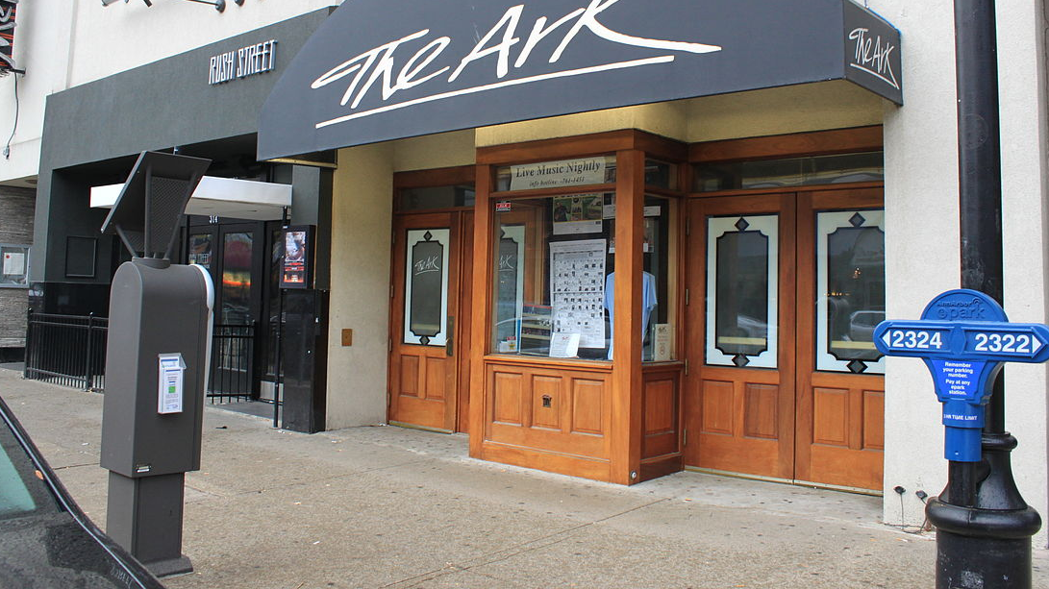
Location
Location 5759 s. Carpenter Chicago, IL 60621
This Photo by Unknown author is licensed under CC BY-SA.

Slide 8
HOOD Broad members
Abby Rameriz, Vanessa Harris, David Stovall, Father Michael Pfleger, Anne Warshaw

Slide 9
Questions and comments
"Hood" (Hope Opportunity Outreach and dissemination)
This Photo by Unknown author is licensed under CC BY-SA-NC.
Notes:
Serve underrepresented families of color experiencing state violence through homelessness, and joblessness,

