Slide 1
Michael Williams
Cycle 48 Presentation

Slide 2
Sports beyond the Ball
NOTE:
To change images on this slide, select a picture and delete it. Then click the Insert Picture icon
in the placeholder to insert your own image.
A 501 (c)(3) nonprofit

Slide 3
Issue
Financial Literacy with the focus on youth.
Understanding of Business and Ethics amongst minorities
*Studies show only 17% of students were required to take at least 1 semester of personal finance.
**Only 24% of Millennials demonstrate basic financial literacy.
*According to the Council for Economic Education
**National Endowment for Financial Education

Slide 4
Mission
Sports Beyond the Balls mission is to combine the basic elements learned in team sport, with both technical, and financial literacy training. My organization helps teach youth values like, resilience, leadership, accountability, respect, and patience. We also take time to teach them about technology in business, and financial literacy with our workshops. This way they not only have fun and build basic development skills, but they also learn important life skills that will be useful in life focusing on financial literacy.

Slide 5
Financial Literacy in the U.S. and America’s youth

Slide 6
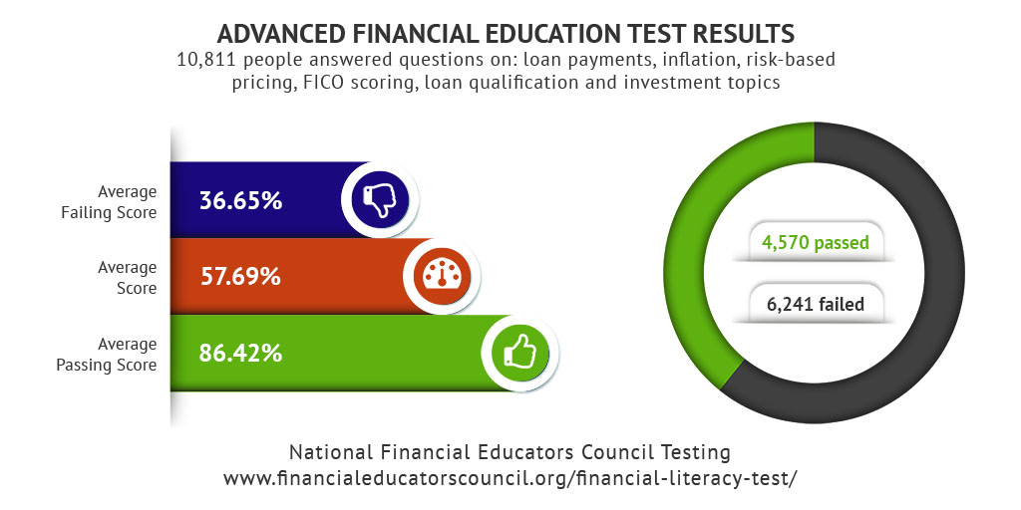
Content with Caption Layout
Caption

Slide 8
Garfield Park Main Office (1st Location)
Near the United Center and various Chicago Park District Locations.
Central to business and Government Sponsors.
Optimal Location for the youth that would have interest in the Program.
Area with an already established Large Market.
Eventual expansion into other large market areas with other sports and financial institutions.

Slide 9
Board of Directors Avis Lavelle (president of Board of Commissioners Chicago Park District) Jose M. Munoz (Board of Commissioners Chicago Park District) John Rogers (Ariel Investment Founder) Mark Levitt (Sr. Director of Business Development- Chicago BULLS Kati Nelson (Youth Marketing Manager- Chicago BULLS) Steven D. Black (Co-CEO, Bregal Investments, inc.) Celebrity Spokespeople Dwyane Wade Derrick Rose

Slide 10
Here is a listing of similar organizations with a similar vision.
Athletes for Hope
https://www.athletesforhope.org/
Beyond Sports Foundation
https://www.beyondsports.org/
Change 4a dollar
http://www.mychange4adollar.com/

