Slide 1
Name:- Jamal Hussain Cycle:- 48 Organization Name:- Nature Needs Care Location:- Lombard Illinois

Slide 2
Nature needs care
Let’s not use plastic.
Let’s plant more trees and stop deforesting.

Slide 3
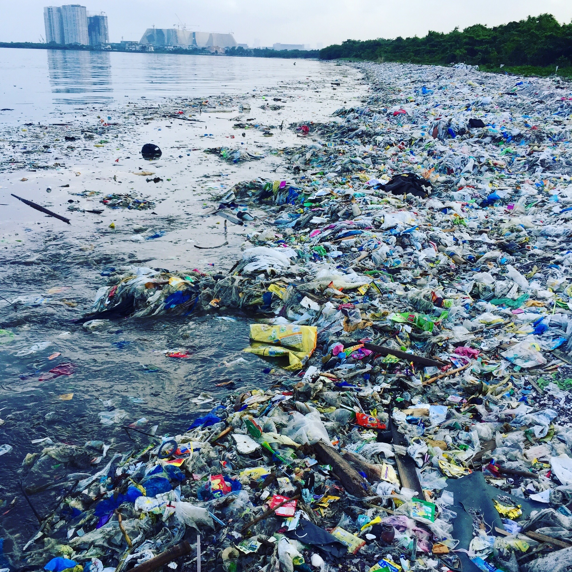
Plastic Use
Normally, plastic items take up to 1000 years to decompose in landfills.
plastic bottles take 450 years.

Slide 4
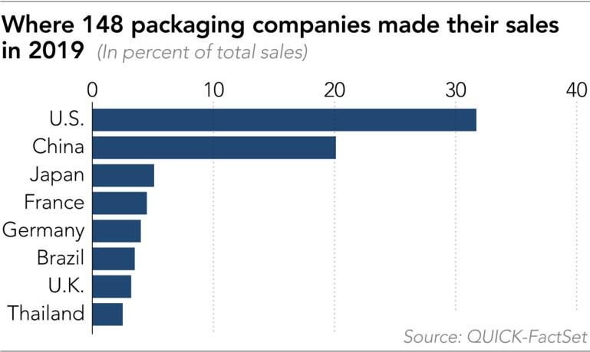
Most use of plastic worldwide

Slide 5
Deforesting
The leading cause of extinction on the planet... On top of that, the capacity of forests to pull greenhouse gases from the atmosphere is lost as forests are cut. Forest loss contributes about 15-20% of all annual greenhouse gas emissions.

Slide 6
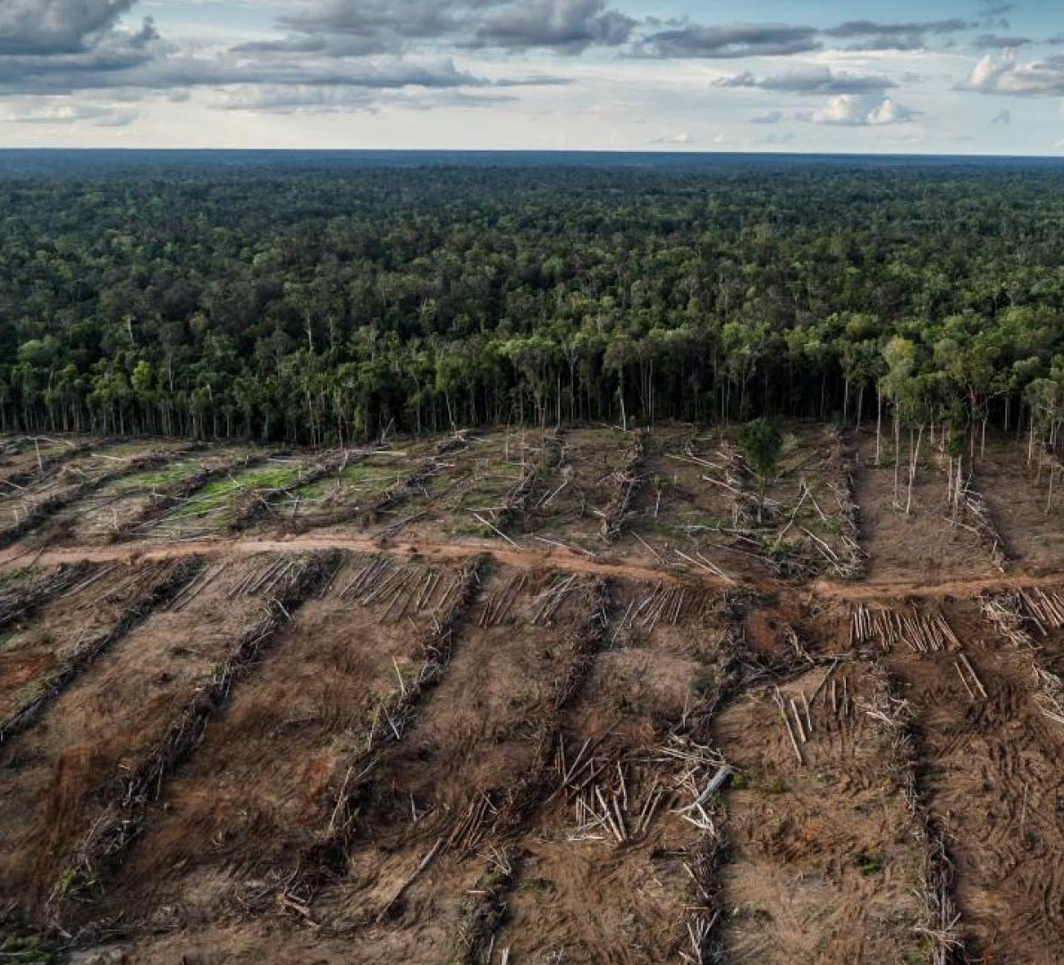
Affects of deforestation
Climate change and imbalance
Health issues
Wildlife Extinction & Habitat Loss
Soil Erosion
Increase in Greenhouse Gas Emissions
Increase in Global Warming

Slide 7
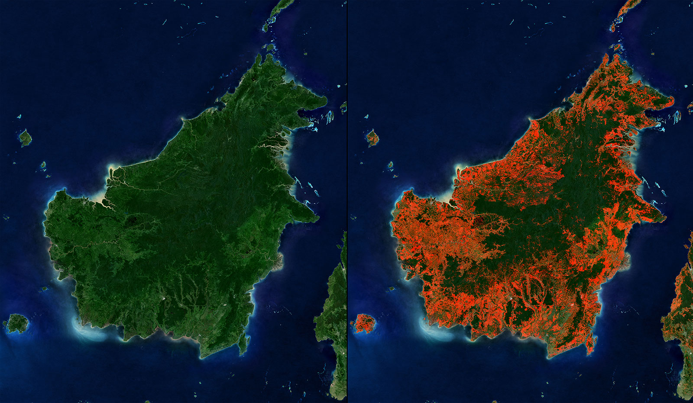
Before vs present view of forest

Slide 8
Mission Statement
To educate people specially the new generations not to use plastics
Plant trees
Make sessions in every single institutions to show how badly use of plastic and cutting tree is affecting us

Slide 9
How to make the sessions affective for people?
Involve teachers in the sessions
Ask doctors to participate
Involve environmentalist
Take arboriculturist on board
Make Meteorologist part of the sessions

Slide 10
Deforesting

Slide 11
Nonprofit organizations working on climate change
Greenpeace USA
Climate solutions
Earth justice

Slide 12
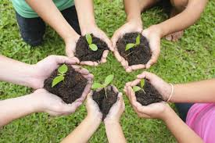
Thank you for taking care of the house where we all live

