Slide 1
Devon Williams
Cycle 44

Slide 2
Union Co-ops
Wait, What?

Slide 3
Union Co-ops Wait, What?
This article written by Amy Dean gives a clear depiction of a new steelworkers deal that can provide more opportunities to workers and to the communities that they are apart of.
These opportunities allow the communities to grow and thrive as well as giving the employees more power by investing in the employees and building union co-ops.

Slide 4
Union Co-ops Wait, What?
The union co-ops is a unionized worker-owned cooperative where worker-owners all own an equal share of the buisness and have an equal vote in overseeing the business.
They are fighting against the hollowing out of companies that are getting their cash and assets drained which causes communities and its workers to be dramatically impacted.

Slide 5
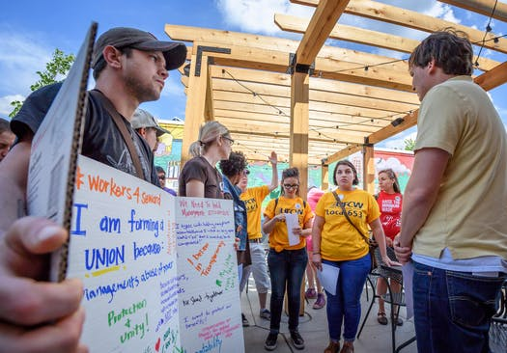

Slide 6
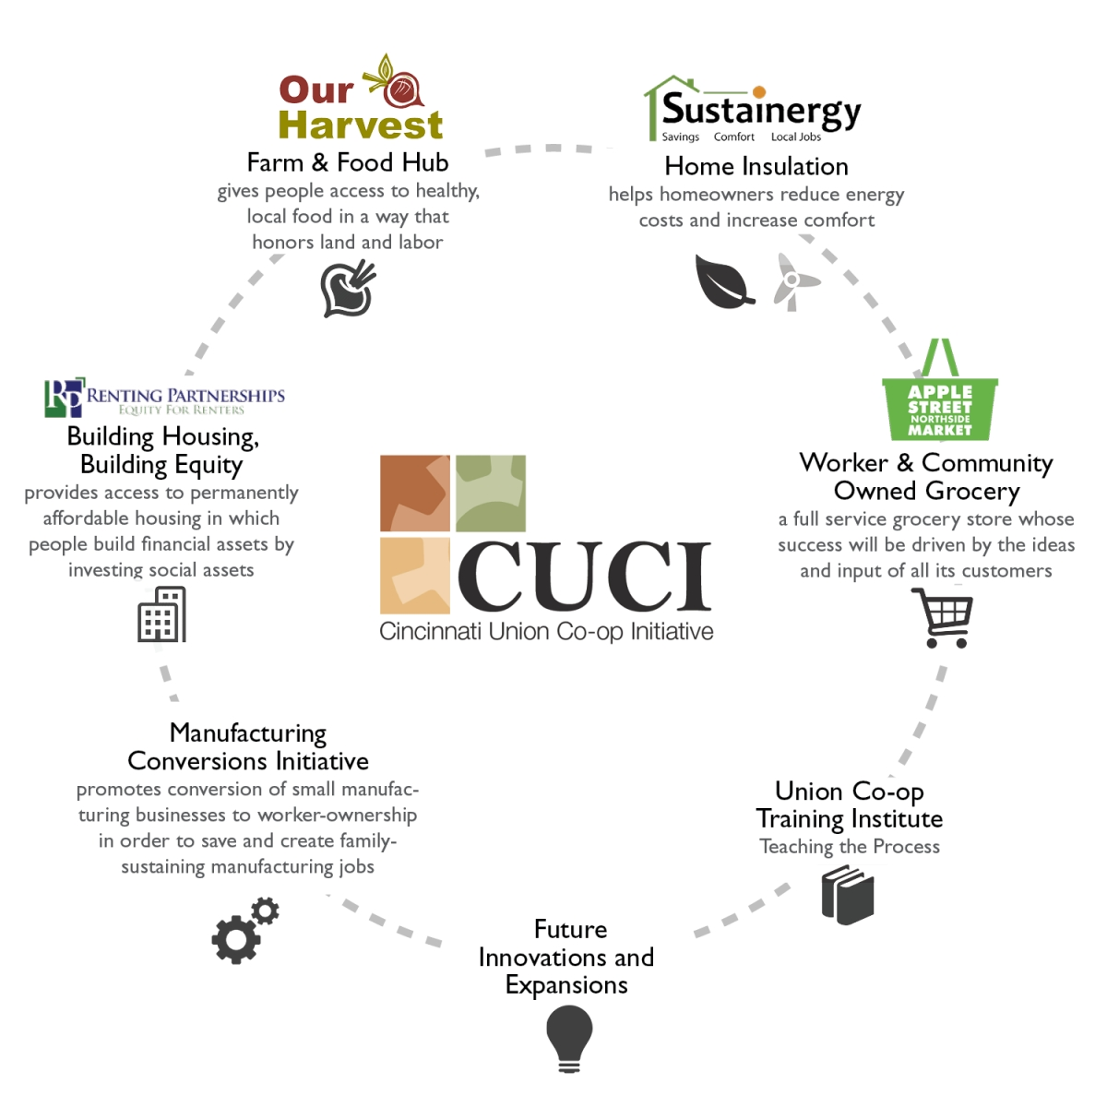

Slide 7
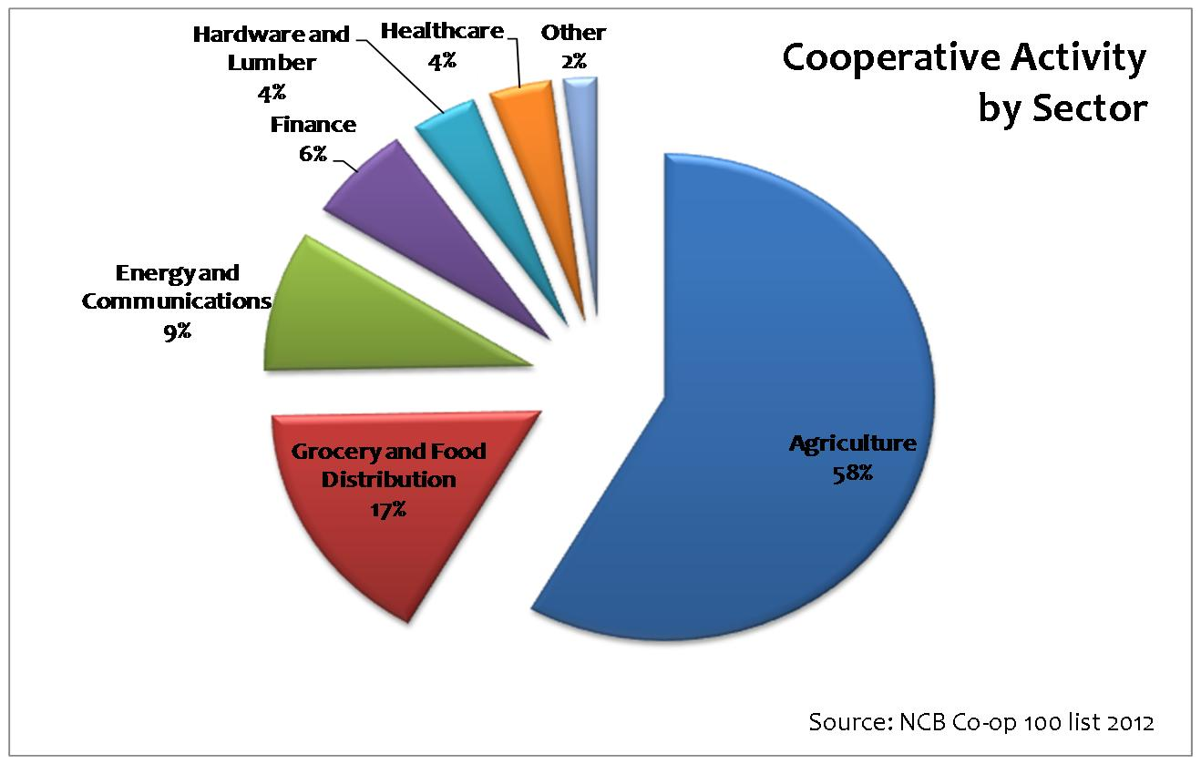

Slide 8
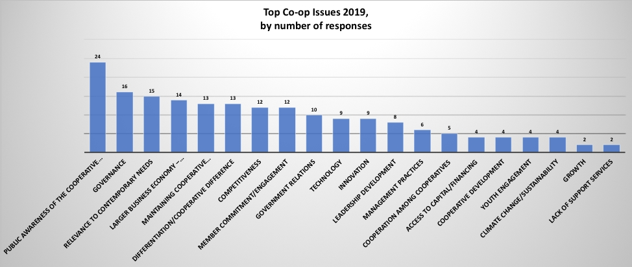

Slide 9
Union Co-ops Wait, What?
To solve the problem of companies being drained by wall street which in return effects the company’s workers and the workers communities I believe that these unionized co-ops need to continue to collaborate with these companies in order to give back to the everyday worker. Show these employees that we care about the communities that are impacted by us and therefore want to contribute to your success and growth as you have with your hard work and dedication.

