Slide 1
CIVICS 101
VIOLENCE, GUNS, AND CULTURES

Slide 2
Written by:
Edited by:
Presented by:
TAMIKA BUTLER
Cycle 44

Slide 3
U.S Society tends to deal with violence as a individual occurrence. Focusing on the “PERPETRATOR” and how they are different from us. The more people killed the more we separate the act from ourselves.

Slide 4
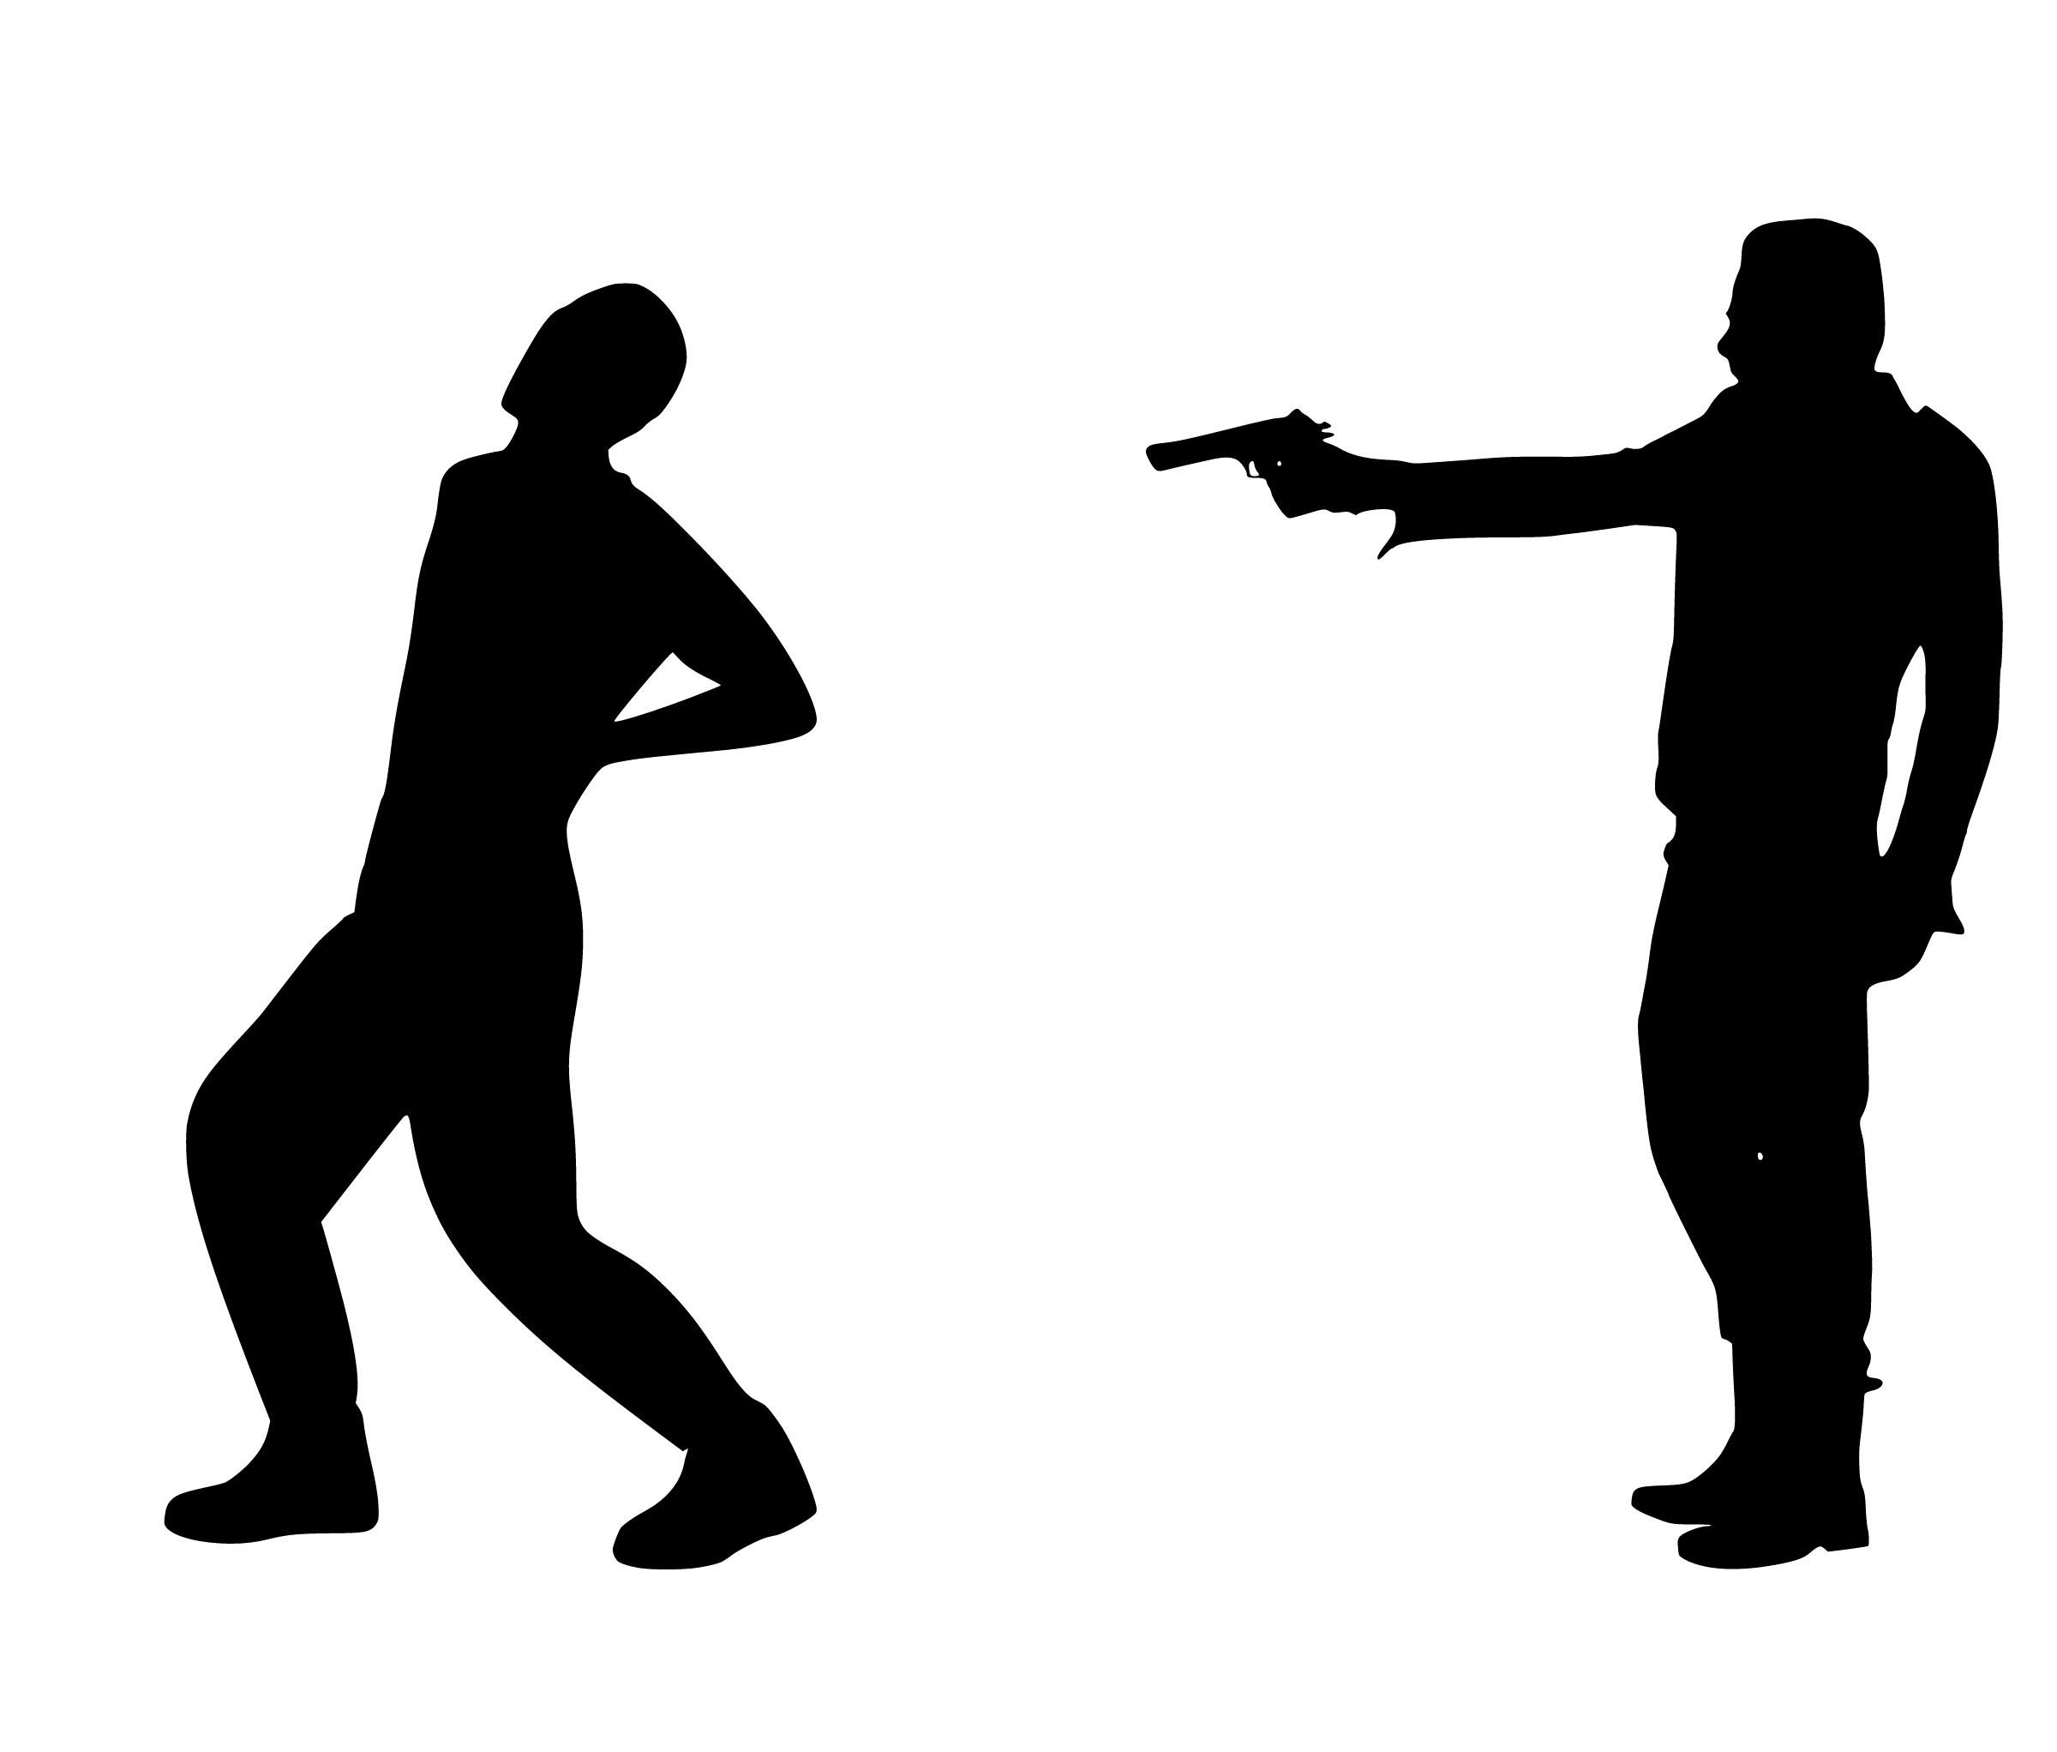
… we usually stigmatize the act, using the differences of race, religion, political beliefs, economic status, mental illness, or some other characteristics.

Slide 5
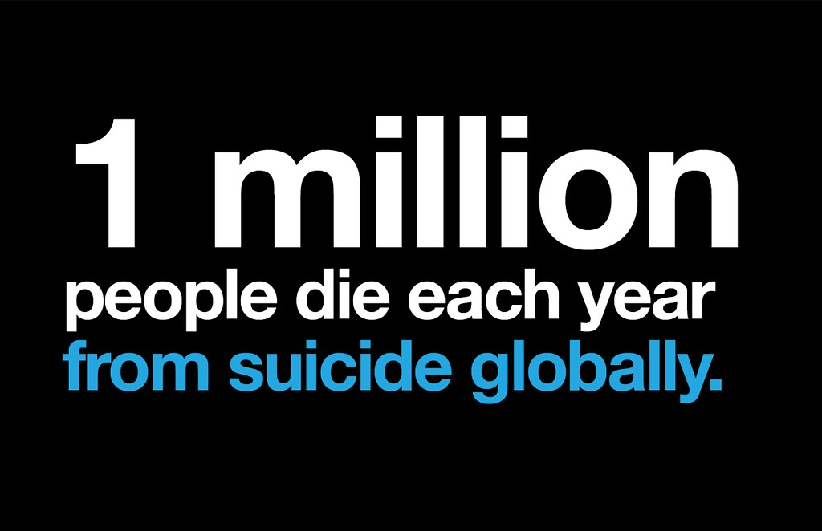
One adding factor to this separation is the acceptance of violence as a means to ;
-DOMINATION
-INDIVIDUALISM
-EXCLUSION
Also known as DIE!!

Slide 6
The opposite of DIE is called O.L.A.. which is only practiced in
HAWAII… ola meaning ...life an health is how the hawaiians express the
values of olu’olu which means compatible, non- conflictive, mellow,
comfortable,and non-dominating..which is some of the main principles
That should be practiced here in the rest of america.

Slide 7
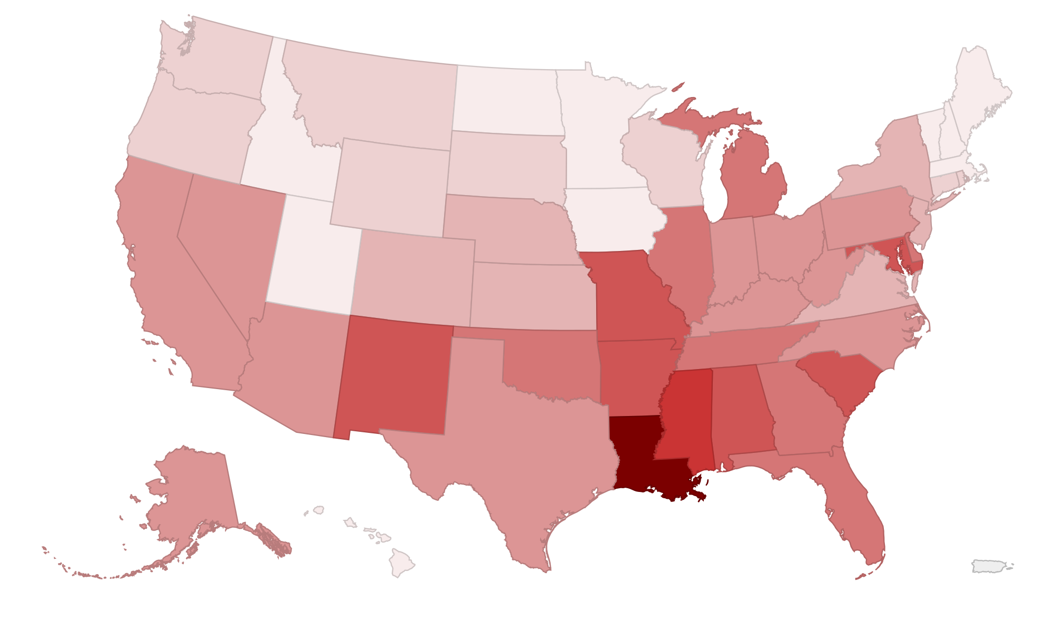
Severely high violence an
Suicide rate
High violence and suicide rate
High crime and violence
Mild crime violence
Lowest crime rates recorded
SOURCE: https://www.bestplaces.net/compare-cities/chicago_il/honolulu_hi/crime

Slide 8
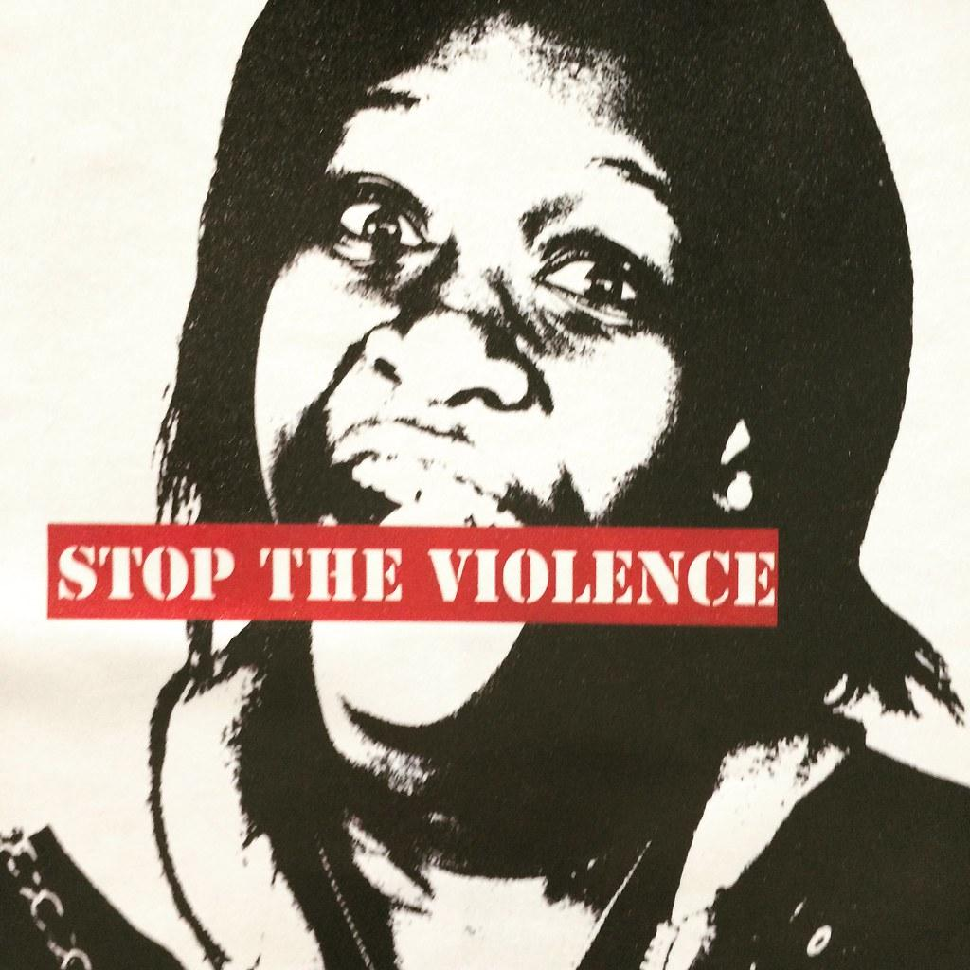
None of us can change the deep culture alone, but we can
have a better common appreciation of the depth of change
to be made. Knowledge is the foundation of a long and
deep change in our society!!!

Slide 9
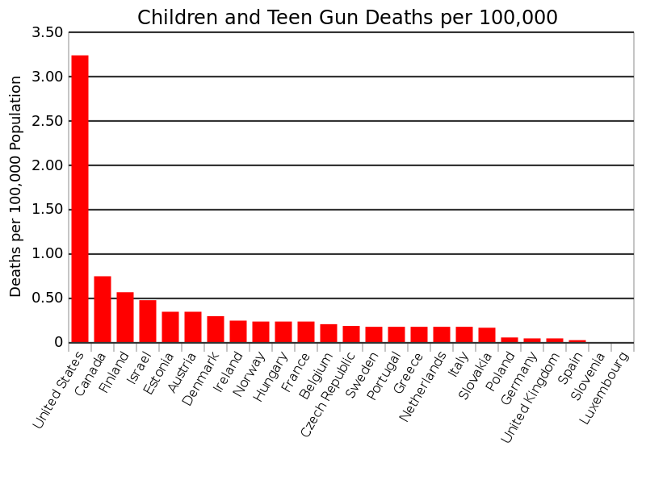
With ola implemented in a
plan.. I think we can improve
this way of life….
…. I believe the children are to
the future.. Teach them well
and let them lead the way!!!
-whitney houston
SOURCE: http://www.gunpolicy.org

Slide 10
