Slide 1
The Healing Process
CIVICS 101

Slide 2
One discussion, Two worlds
Sharon Leslie Morgan and Thomas Norman DeWolf authored a book called, “Gather at the Table”. The book was written with the intention to address and begin the healing process of the many wounds “Americans” inherited from the legacy of slavery.

Slide 3
The Drive
Sharon and Tom were sitting in her jeep after leaving the National Voting Rights Museum and Institute, at the foot of the Edmund Pettus Bridge. This is in Selma, Alabama, where more than 600 protestors tried to begin a 54 mile march to Montgomery, in March of 1965. This day became day became known as “Bloody Sunday”.

Slide 4
A bit of History
Sharon and Tom first met in 2008, through a nonprofit organization founded by the descendants of both slaveholders and enslaved people. In 2009 Sharon and Tom began a journey to test whether two people- an African American woman from the South side of Chicago who is descended from enslaved people, and a white man from central Oregon who is descended from the largest slave-trading dynasty in U.S, history- could come to grips with deep, traumatic, historic wounds and find healing.

Slide 5
Back to the Drive
As Sharon and Tom sat in her Jeep, she became overwhelmed with emotion, started to cry because suddenly Tom’s face “morphed into a representation of all white people and everything they had done to people like me”. Tom just sat next to Sharon as she cried and his thoughts were, “ I didn’t know what to say. So I said nothing”. Moments later Tom asked Sharon what would she have done if she had lived there at that time. Sharon replied that she would have killed them. Tom states that he believes in love and peace, and want everyone to get along. However he stated, “The hard truth is that my face does represent the face of oppression. I’m white, I’m male”, and at one point “blissfully unaware of my unearned privilege.

Slide 6
Some effects of Racism

Slide 7
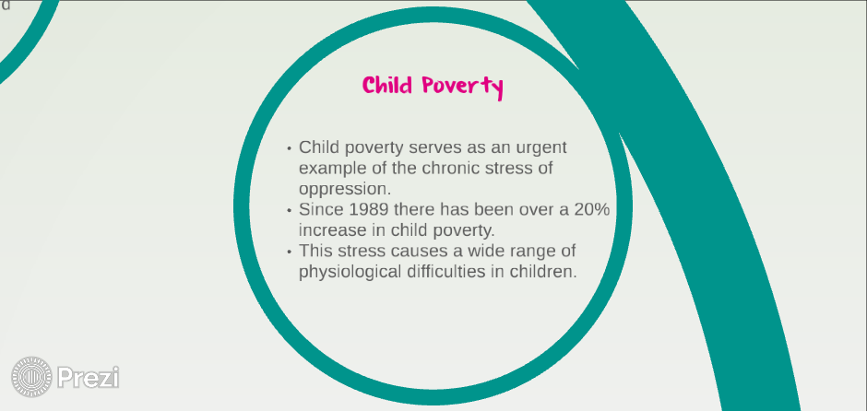
Historical wounds and our Youth

Slide 8
Department of Justice
A wound is defined as, an injury to living tissue caused by a cut, blow, or other impact, typically one in which the skin is cut or broken. A wound is also defined as an injury on (someone). Synonyms: injure, hurt, harm.
The first step to healing a wound is to acknowledge who or what has been harmed, hurt, injured or broken.
The second step is to have empathy or compassion, to understand the root cause of the injury.
I would approach the healing of our history’s wounds in similar fashion as the journey that Sharon and Tom embarked upon. I would recommend more conversations, meetings and dialogue. We must present facts in addition to our emotional response to injustice. I would also advise the “face’ who represents oppression to speak with the oppressor.

