Slide 1
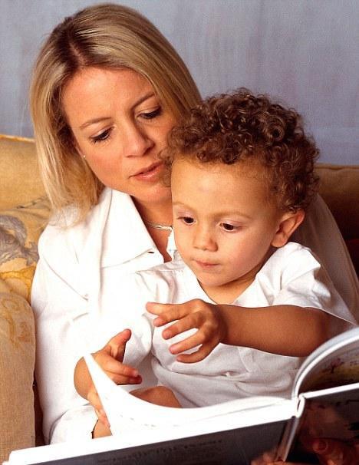
Regurgitation of a People:
The Story of Black America
Presented by: Stephanie K. Banks

Slide 2
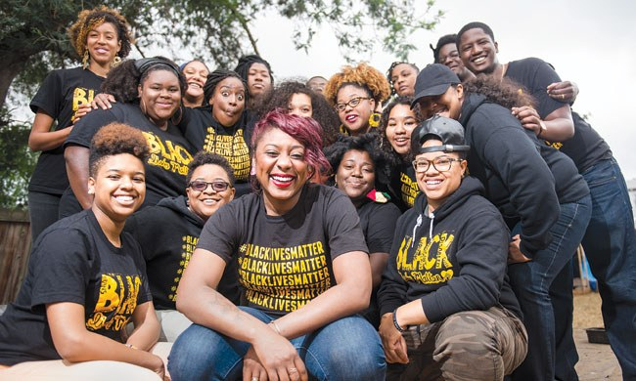
Summary: Black Lives Matter
Page 33
Discusses the founder of “Black Lives Matter” and how the hashtag came to fruition.
Ferguson Rally
Reiterates Hardship of Black
Communities

Slide 3
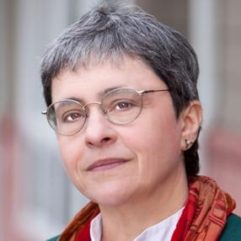
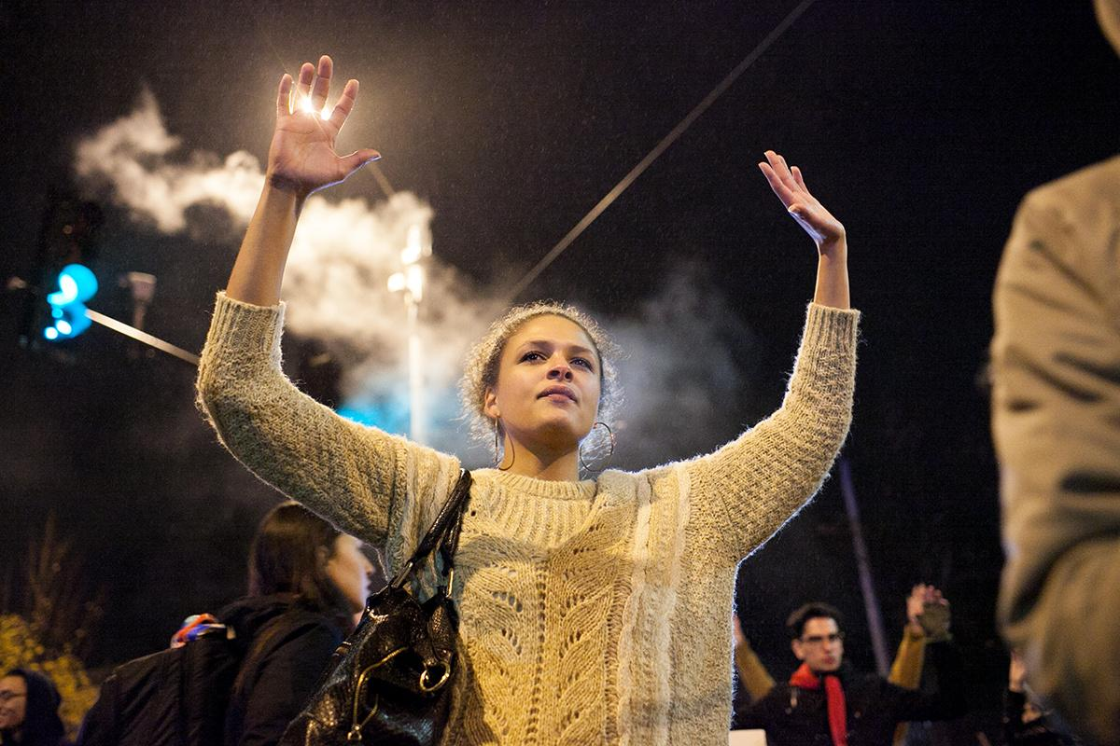
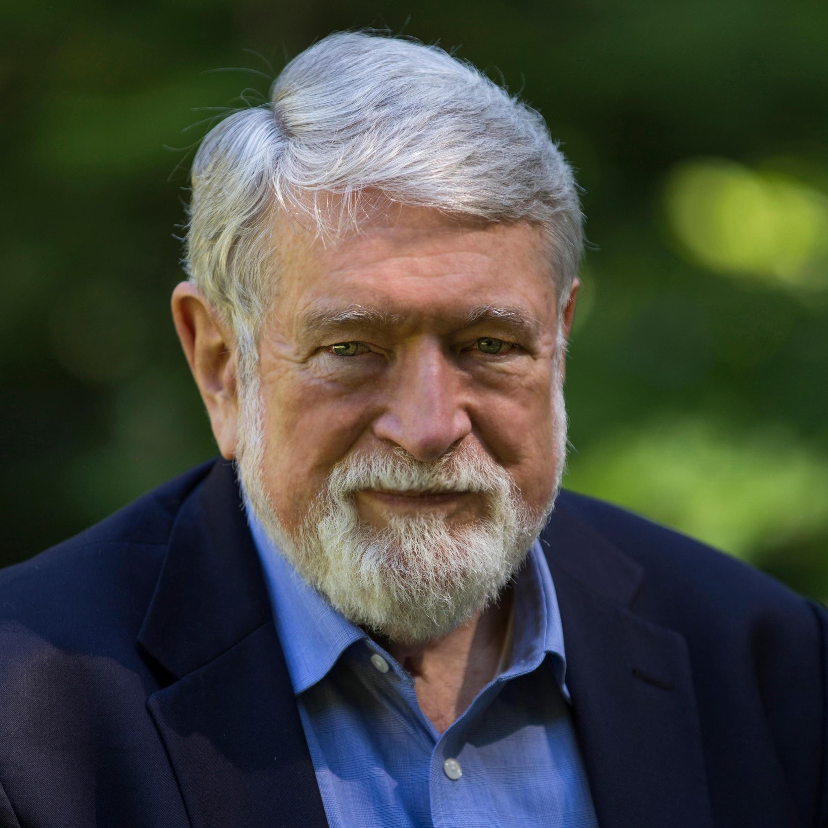
The Issue
Sarah Van Gelder
Liz Pleasant
David Korten
American author, former professor of the Harvard Business School, political activist, prominent critic of corporate globalization, and "by training and inclination a student of psychology and behavioral systems".
Sarah van Gelder is cofounder and editor-at-large of the award-winning YES! Magazine. She explores the leading edge of change, writing and speaking internationally on a wide range of topics.

Slide 4
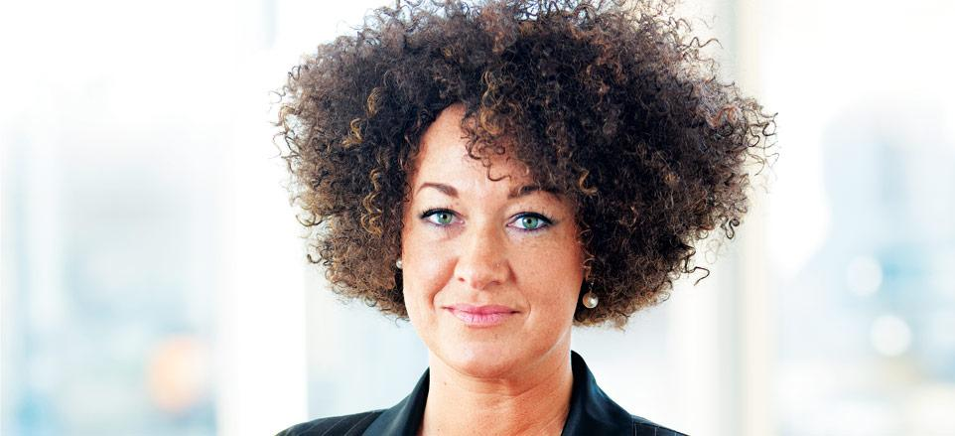
Supporting Key Elements
Top Graduate Schools for African American History
(based on usnews.com)
Rachel Dolezal
Rutgers, The State University of New Jersey, New Brunswick
Duke University
University of Maryland- College Park
University of North Carolina- Chapel Hill
Yale University

Slide 5
The Solution...

