Slide 1
Healing the community from the inside
Marco Merino
#42

Slide 2
Unnecessary Tragedy in our communities
With advancement in media we can first hand see the ugly reality of what too much force from police can lead to.
Strongest police force in the world and increasing militarization of departments have led to force be readily available.
US has highest deaths per capita by hands of those who have taken the oath to protect us.
Shot estimated 2018=680, 2017=990, 2016=960, 2015=995, does count those that have perished from brute force, been run over, died of neglect,

Slide 3
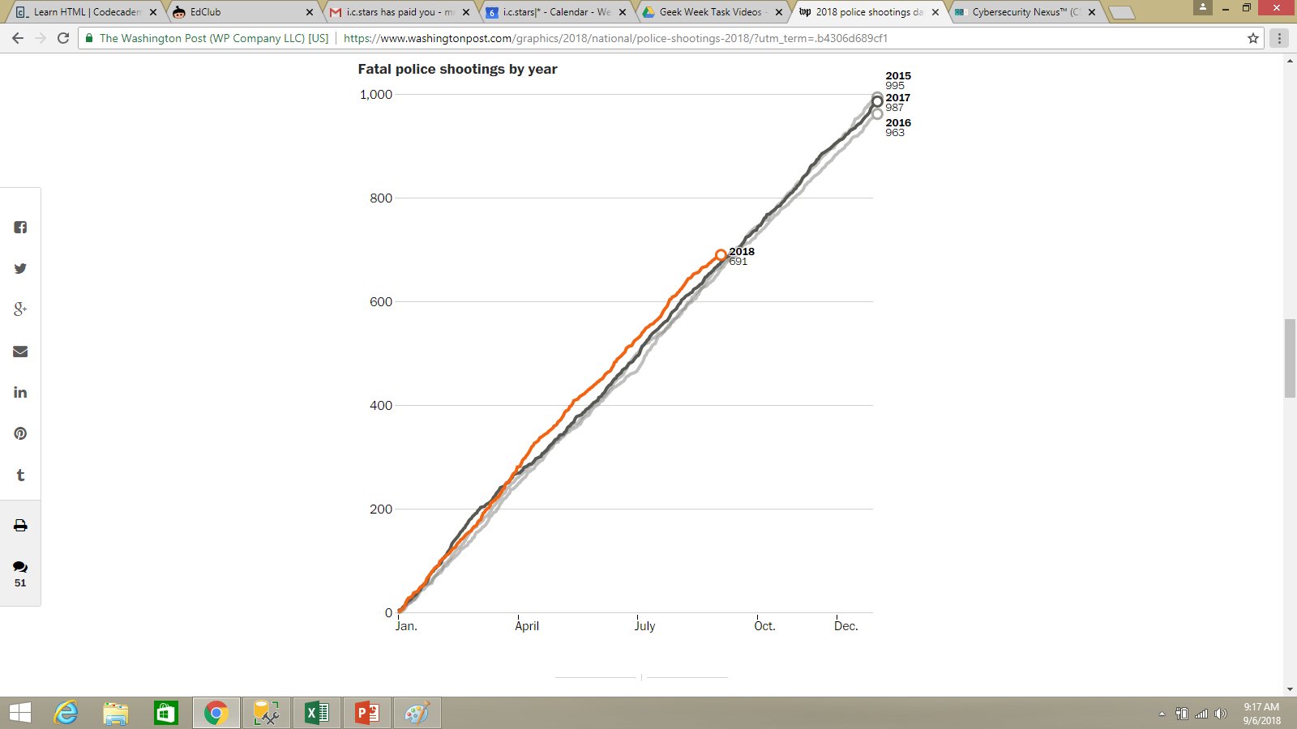

Slide 4
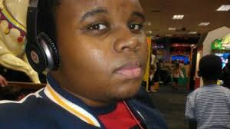
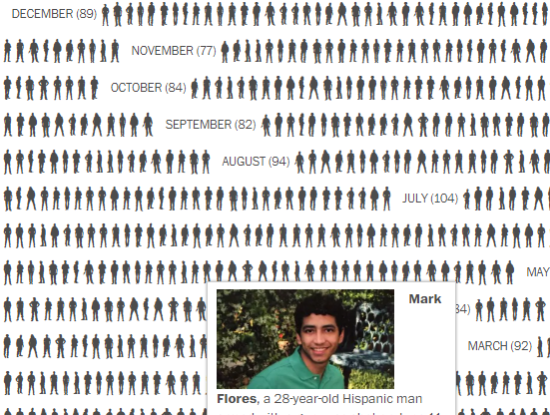

Slide 5
Belonging to the community
Presidents Task Force on 21st Century Policing, US Conference of Mayors
14 Billion in grants from the Community Oriented Policing Services (COPS=office of DOJ) since 1994
Strategies Implemented
“by the book” decriminalization
Specialized personnel to identify mental illness
Diversification
“coffee with a cop”

Slide 6
Progress?
Conscious Communications
Reinvent Ourselves

