Slide 1
COMMUNITY POLICING
Denzel Ruffin, Cycle 42

Slide 2
SUMMARY
Need for improved policing
Who are the police?
What is their purpose?

Slide 3
THE PROBLEM
Policing - an important public service job - has serious flaws that need addressing in order to represent the mission to protect and serve the community

Slide 4
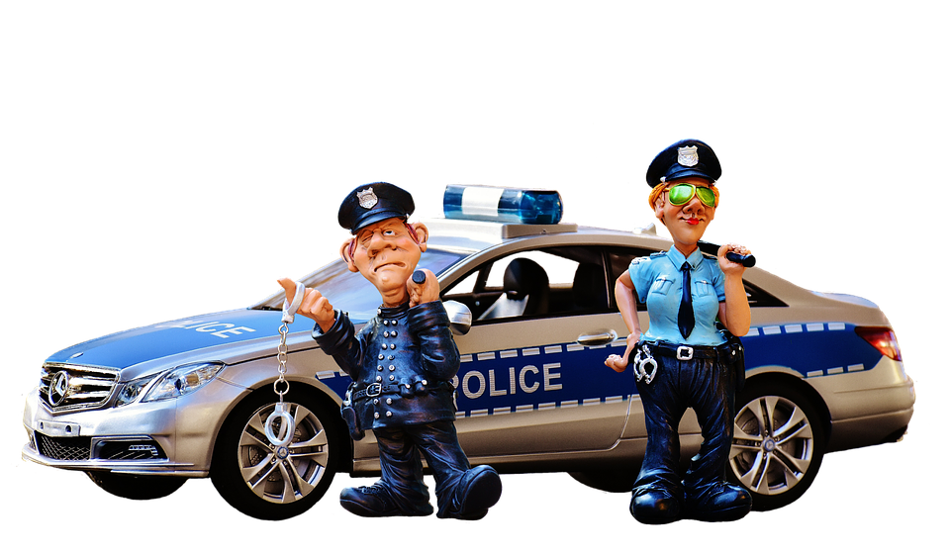
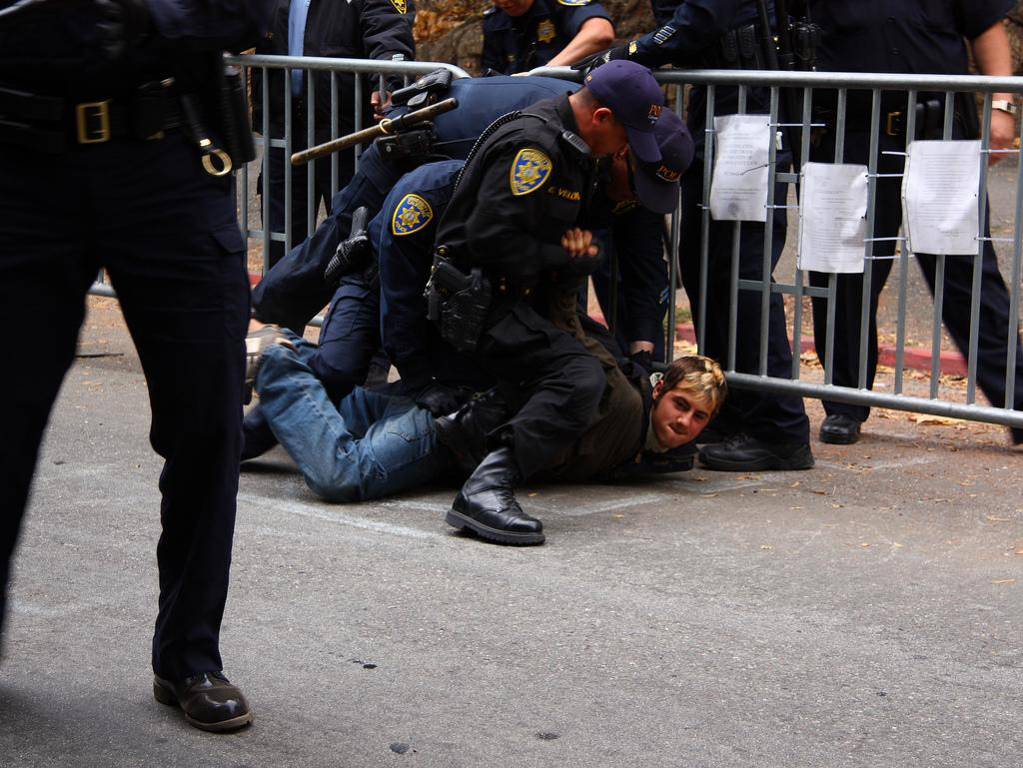
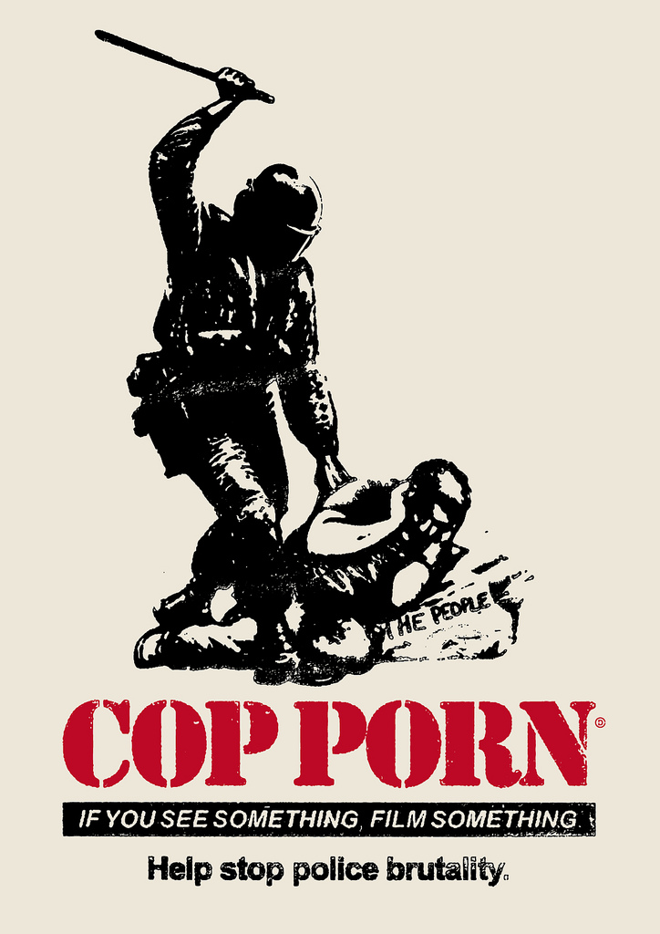
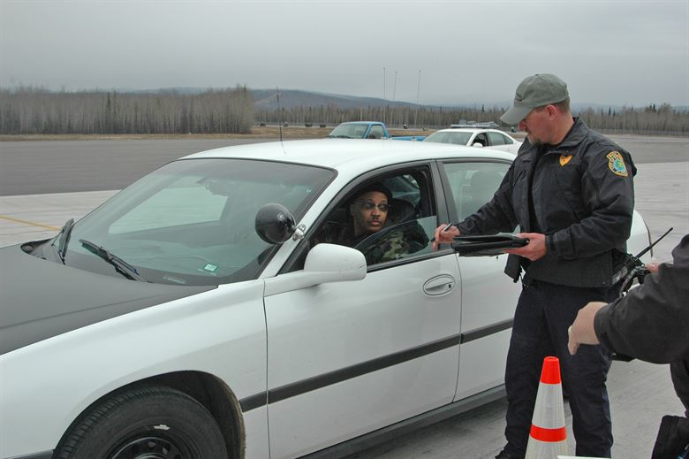
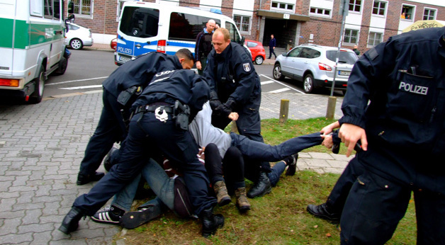
It’s a hard job, putting your critical thinking skills to the test and your life on the line.

Slide 5
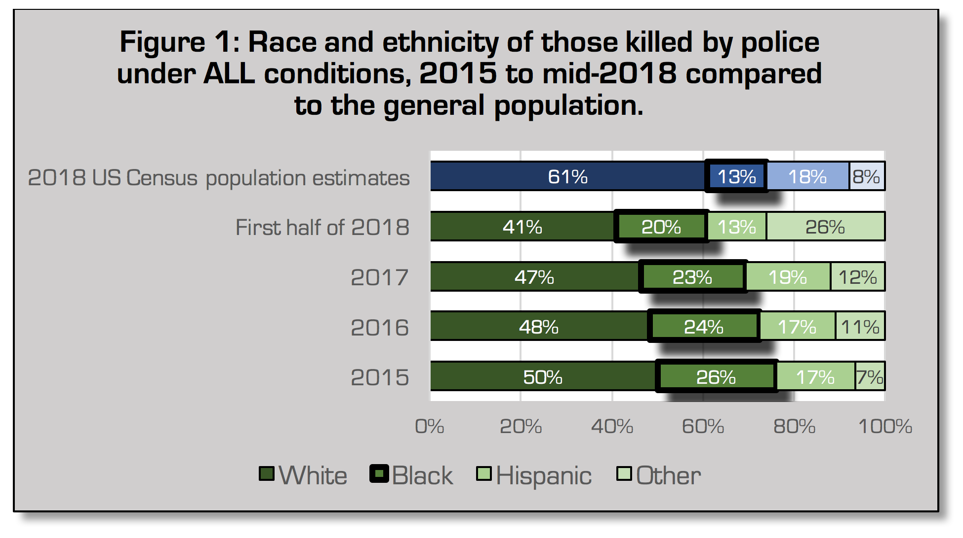
https://thesocietypages.org/toolbox/police-killing-of-blacks/

Slide 6
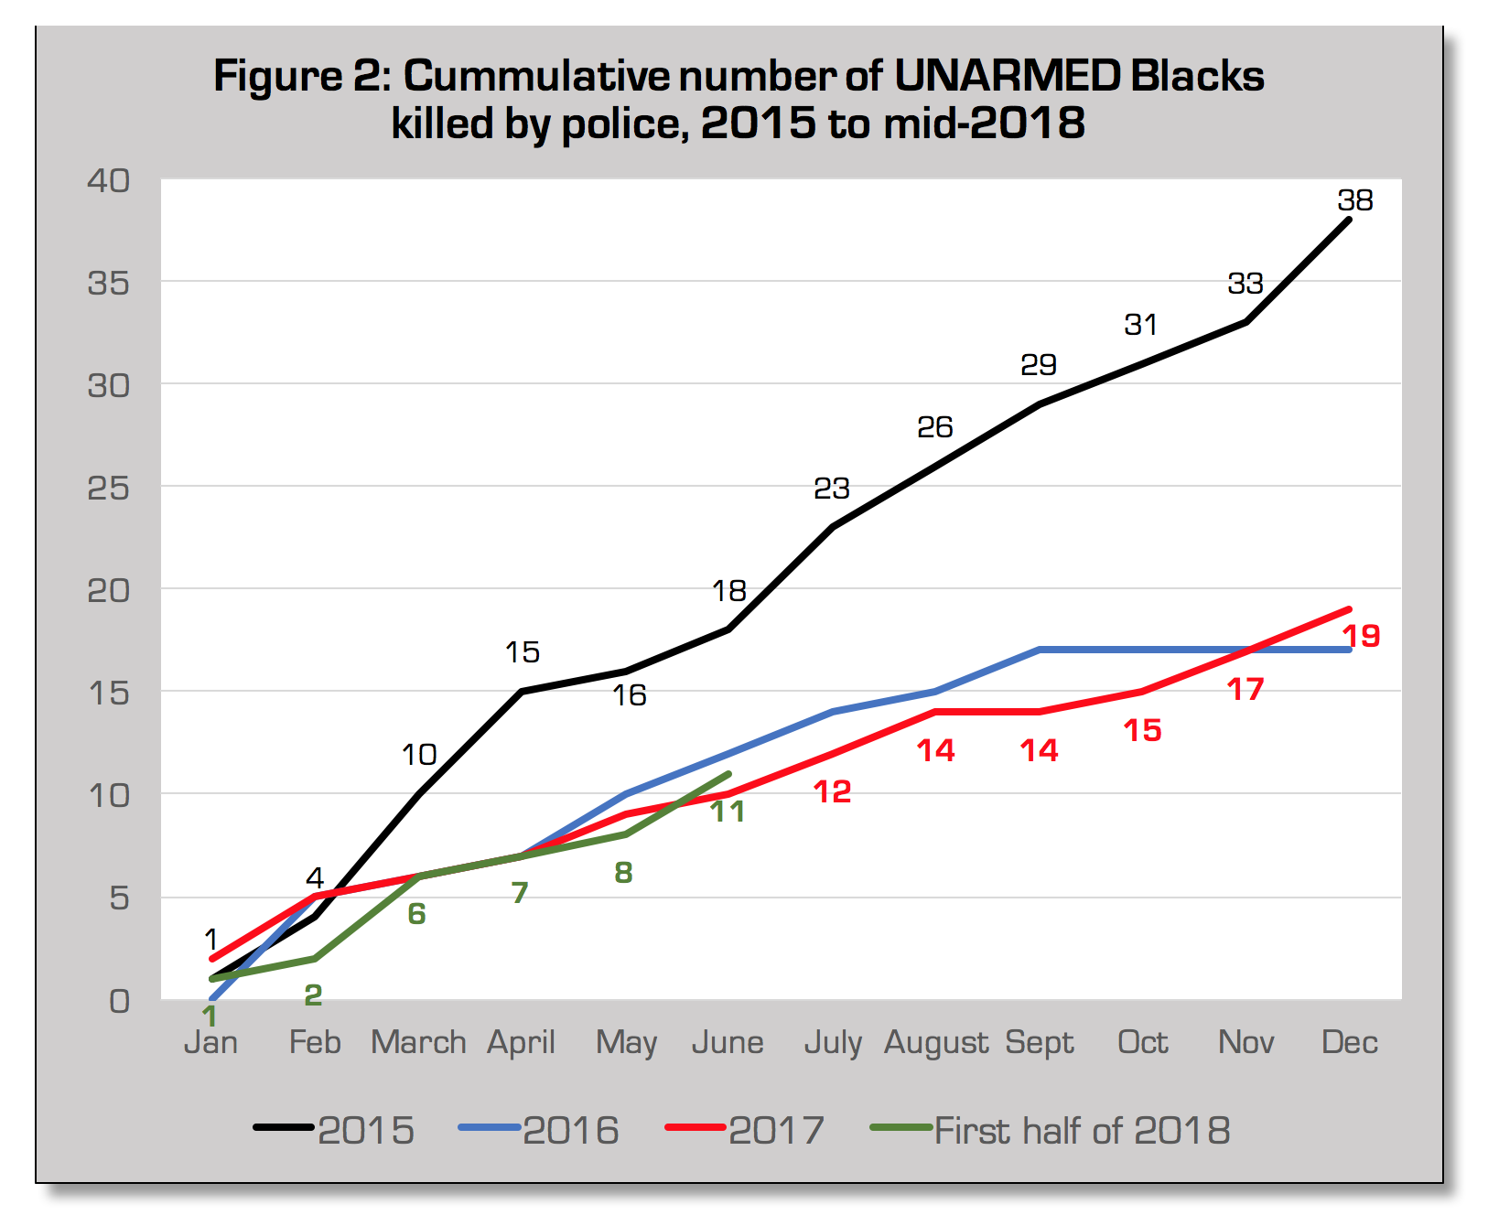
https://thesocietypages.org/toolbox/police-killing-of-blacks/

Slide 7
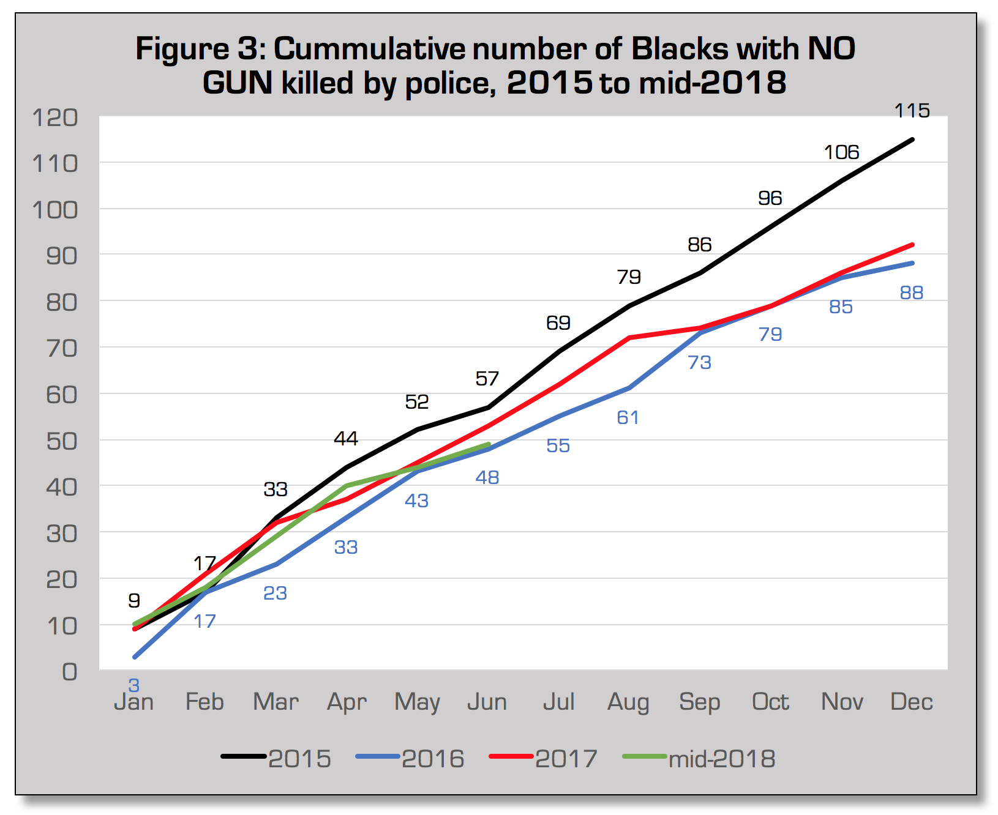
https://thesocietypages.org/toolbox/police-killing-of-blacks/

Slide 8
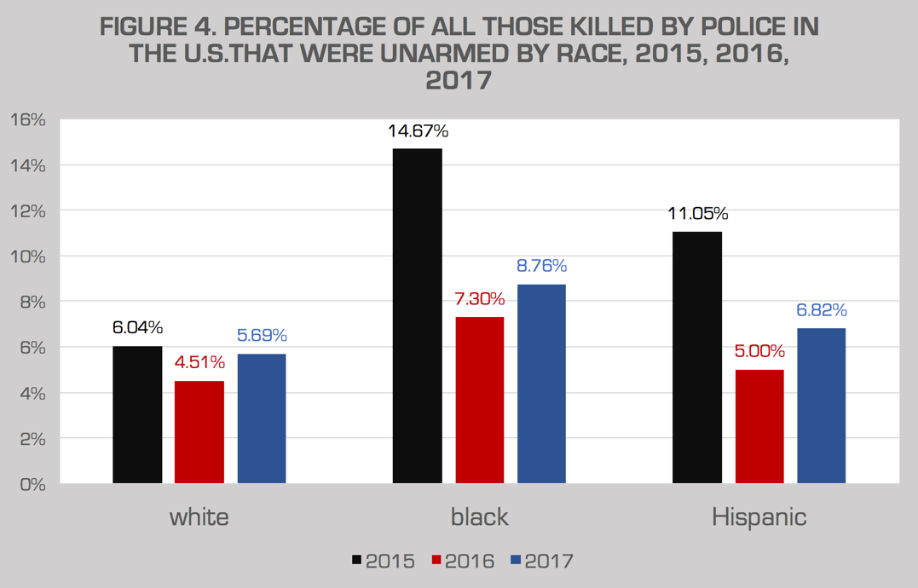
https://thesocietypages.org/toolbox/police-killing-of-blacks/

Slide 9
MY SOLUTION
Community activism should be a requirement in the police force. For the interest to be high in regards to protecting and serving, a connection is needed to develop a relationship. A natural desire to be of service to the community rather than enforce the law will be the difference that changes community policing

Slide 10
CLOSING REMARKS
Community policing is an effective way to save lives and improve “bad” neighborhoods. If implemented correctly, perceptions on both ends can change. For both the community and the police

