Slide 1
When Cops Belong To The Community
Corey Williams C41

Slide 2
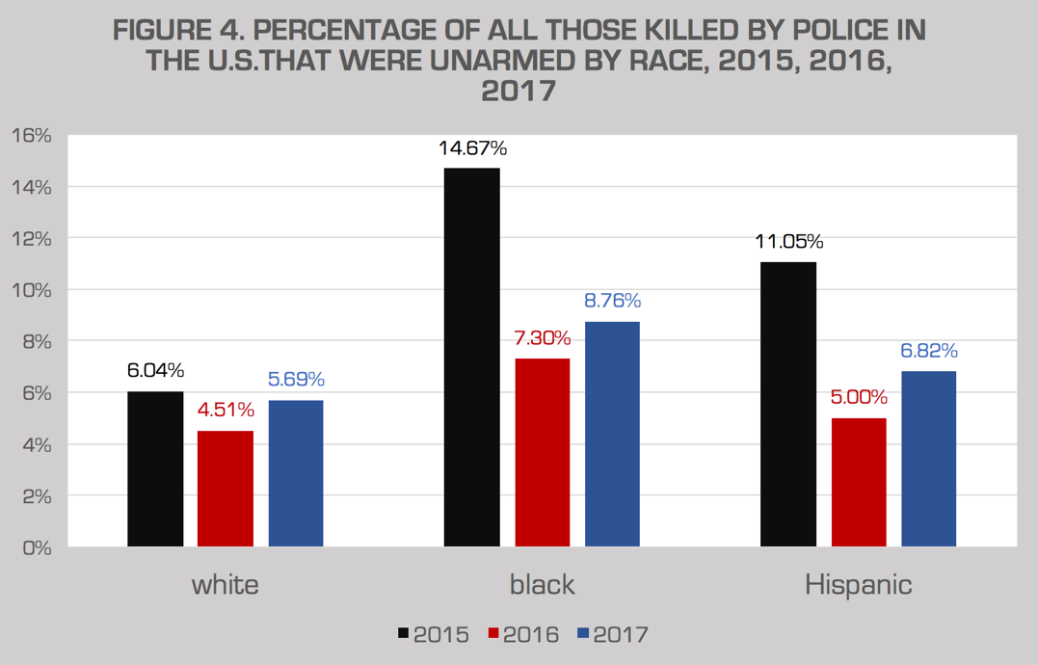
Summarize
Nation attention has been focused on the motto: “Serve and Protect”. The citizen of the United States of America believe that police are abusing their power.

Slide 3
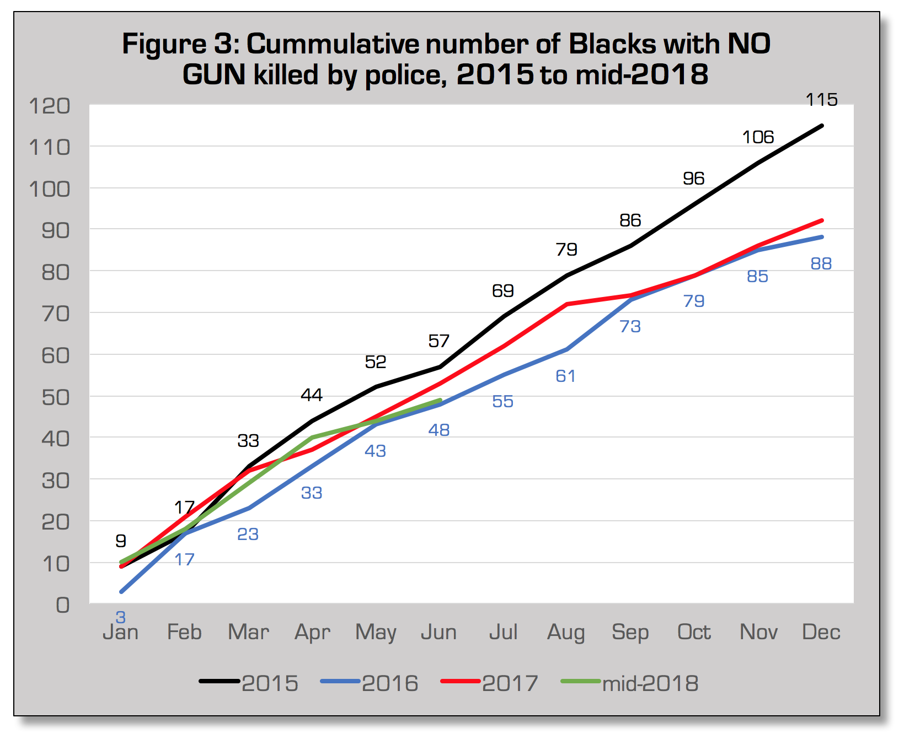
Fight
In the article: “when cops belong to the community” the fight was to get more community based policing.This strategy is effective because it will allow police not to look for broken laws but keep peace within the communities.

Slide 4
My Solution
I believe that there should be a law educated board that review all police forceful actions.This gives people who have been wrongly done by the police a voice and power.

